Slide 1


Promotional version
Additional changes may apply
N4 Fault Finding and Protective Devices

Slide 2
  Module 1: Heavy current
INTRODUCTION
Every electrical fault situation is unique and demands its own approach. Only with experience will the electrician learn to conduct the best fault-finding process possible for a given situation. Approaches to and methods for fault finding are intended to guide the electrician in finding and fixing the fault in a malfunctioning electrical circuit as safely and efficiently as possible.
www.futuremanagers.com

Slide 3
  Module 1: Heavy current (continued)
FAULT-FINDING
Fault finding refers to the testing of electrical equipment to determine whether the circuit is working safely and correctly
Fault finding should always be performed within the following constraints:
Safety – this entails the safety of people, property, and the environment.
Economics – the time and money spent on finding the problem and purchasing materials required to fix it needs to be considered.
www.futuremanagers.com

Slide 4
  Module 1: Heavy current (continued)
THE STEPS IN THE FAULT-FINDING APPROACH
Step 1: Define the problem
Step 2: Collect the facts and evidence
Step 3: Analyse the information and single out the facts
Step 4: Eliminate possibilities and locate the fault
Step 5: Determine the cause of the fault and remove it
Step 6: Rectify the fault by fixing it
Step 7: Solve the problem by checking the system
www.futuremanagers.com

Slide 5
  Module 1: Heavy current (continued)
DOCUMENTATION AIDS FOR FAULT FINDING
A fault finder can make use of three documentation aids when proceeding to find a fault in an electrical circuit. They are the completion of workload, the equipment problem documentation and the recommended for repair documentation.
www.futuremanagers.com

Slide 6
  Module 1: Heavy current (continued)
METHODS OF FAULT FINDING
Depending on the complexity and accessibility of the electric circuit, different methods of fault finding can be used, including:
The scientific approach;
The systematic approach; and
The half-cut method.
www.futuremanagers.com

Slide 7
  Module 1: Heavy current (continued)
SCHEMATIC DIAGRAMS
The qualified electrician must be able to draw the circuits of the starting methods of three-phase induction motors and read their circuits diagrams, to understand their operation.
www.futuremanagers.com

Slide 8
  Module 1: Heavy current (continued)
ACTION AND REACTION STARTING METHODS
Circuit operation for the direct-on-line starting method;
Forward-reverse starting method of a three-phase induction motor;
Circuit operation for forward-reverse starting method;
Star-delta starting method;
Circuit operation of the star-delta starting method;
Slow-fast starting method; and
Circuit operation of the slow-fast two-speed starting method.
www.futuremanagers.com

Slide 9
  Module 1: Heavy current (continued)
MEASURING INSTRUMENTS
It is essential for fault finders to understand the working of measuring instruments to perform their tasks.
www.futuremanagers.com

Slide 10
  Module 1: Heavy current (continued)
VOLTAGE TESTER
This is an instrument for the detection of voltage and current in an electrical circuit. The voltage tester is a measuring instrument used for the detection of alternating current (AC) voltage and current in electrical power circuits.
www.futuremanagers.com

Slide 11
  Module 1: Heavy current (continued)
MOVING-COIL METER
The moving-coil meter is an analogue instrument which is used to measure small currents. It is a widely used measuring instrument which works on the principle of the DC motor.
www.futuremanagers.com

Slide 12
  Module 1: Heavy current (continued)
THE WHEATSTONE BRIDGE
The Wheatstone bridge makes use of a set of known resistances which are balanced to determine the value of an unknown resistor accurately. The Wheatstone bridge is an electrical circuit consisting of a set of known resistors arranged in a particular way to measure the value of an unknown resistor very accurately by balancing the voltages of the two legs of the circuit.
www.futuremanagers.com

Slide 13
  Module 1: Heavy current (continued)
ANALOGUE VOLTMETER
The analogue voltmeter makes use of a moving-coil galvanometer and is called a permanent magnet moving-coil (PMMC) voltmeter. To protect the galvanometer, it must always be connected with a series resistor.
www.futuremanagers.com

Slide 14
  Module 1: Heavy current (continued)
AMMETER
The analogue ammeter also makes use of a PMMC. When used as an ammeter the moving coil must be connected in series with the circuit. It must also be protected by a parallel (or shunt) resistor through which most of the current is deviated when the current is measured.
www.futuremanagers.com

Slide 15
  Module 1: Heavy current (continued)
DIGITAL MEASURING INSTRUMENTS
Digital instruments work on a different principle to analogue instruments. They have quite intricate circuit diagrams, with most of their electronic components contained in one integrated circuit (IC) which performs most of the signal processing and display of the measurements.
www.futuremanagers.com

Slide 16
  Module 1: Heavy current (continued)
MOTOR PROTECTION
Electrical induction motors are used in all sectors of industrial, commercial, and domestic industries, and while motors are expensive, the components that can be used to protect them are not so costly. It is imperative to include the necessary motor protection equipment in the main power and control circuitry of electrical motors. Motors can be protected against a number of faulty conditions that can be harmful including overload, overcurrent, low voltage, high voltage, phase failure, phase reversal and ground faults.
www.futuremanagers.com

Slide 17
  Module 1: Heavy current (continued)
TYPES OF OVERLOAD PROTECTION
There are mainly three types of overload protection devices, namely thermal overload relays, electromagnetic overload relays and electronic (solid state) overload relays. Although electronic overload relays are gaining in popularity because of their versatility and relatively low cost, thermal overloads are widely used, especially bimetal thermal overloads.
www.futuremanagers.com

Slide 18
  Module 2: Light current
THE CATHODE RAY OSCILLOSCOPE (CRO)
An oscilloscope is a measuring instrument that measures voltage signals and displays them on a screen. There are basically two types of oscilloscopes, digital oscilloscopes, and CRO’s. Most oscilloscopes are built with two input channels, which can both be displayed on the screen individually or simultaneously.
www.futuremanagers.com

Slide 19
  Module 2: Light current (continued)
PROPERTIES OF THE OSCILLOSCOPE
To display the shape of a signal.
To distinguish between AC and DC.
To measure the amplitude of a signal.
To display and measure properties of voltage spikes and pulses.
To measure the period of an AC signal and calculate the frequency.
To display and measure the phase shift between two AC signals.
To measure the voltage across a known resistor and calculate the current.
www.futuremanagers.com

Slide 20
  Module 2: Light current (continued)
FUNCTIONS OF THE CRO COMPONENTS
The most commonly used CRO is the dual trace oscilloscope. This must not be confused with the dual beam oscilloscope. The dual trace oscilloscope has only one electron gun which produces one electron beam, whereas the dual beam has two electron guns, one for each channel. The electron beam of the dual trace CRO is switched between the two channels to display both input signals as two traces on its screen.
www.futuremanagers.com

Slide 21
  Module 2: Light current (continued)
FACTORS THAT AFFECT RESISTORS
When a specific material is used to form a resistor there are a number of factors that affect the resistance of that material:
Resistivity of a certain material;
Length of the resistor;
Cross-sectional area of the resistor; and
Temperature of the resistor.
www.futuremanagers.com

Slide 22
  Module 2: Light current (continued)
FACTORS THAT INFLUENCE CAPACITORS
The ability of a capacitor to store electric charge is called its capacitance, and this is influenced by the following factors:
The surface area of the capacitor plates;
The distance between the plates; and
The properties of the dielectric material.
www.futuremanagers.com

Slide 23
  Module 2: Light current (continued)
METAL OXIDE RESISTORS
Metal oxide resistors consist of a ceramic rod that is covered with a metal oxide film as the resistive material to limit the flow of electric current. The metal oxide is made of a combination of tin and antimony oxide which is deposited as a thin film on the cylindrical surface of the ceramic tube.
www.futuremanagers.com

Slide 24
  Module 2: Light current (continued)
CERAMIC CAPACITORS
Ceramic capacitors are fixed, non-polar capacitors, making use of a ceramic material as a dielectric. There are mainly three types of ceramic capacitors available:
Disc capacitors with leads for through-hole mounting;
Multi-layer ceramic capacitors (MLCC) for SMT mounting; and
Bare leadless disc ceramic capacitors for PCB slot mounting.
www.futuremanagers.com

Slide 25
  Module 2: Light current (continued)
IEC SYMBOLS IN ELECTRICAL CIRCUITS
In electrical circuits the components are represented by standardised symbols, even though the components are manufactured by different manufacturers. This makes it easier to draw and read electrical circuits. Although there are different standards worldwide, it is good practice to use only one standard in a drawing.
www.futuremanagers.com

Slide 26
  Module 2: Light current (continued)
RECTIFIERS
In electrical terms, rectification means to change a sinusoidal AC voltage into a DC voltage by means of a rectifier circuit. The DC power supply is such a circuit that changes the AC input voltage into a smooth DC output voltage. The basic rectification process is achieved through diodes which conduct electrical current only in one direction.
www.futuremanagers.com

Slide 27
  Module 2: Light current (continued)
FUNCTIONING OF THE ZENER DIODE
The Zener diode is used in its reverse bias region and makes use of the reverse breakdown voltage, as the reverse breakdown voltage curve is quite steep, the voltage remains fairly constant over a relatively large current range. The reverse breakdown voltage, also called the Zener voltage, can be controlled by the amount of doping during the manufacturing process of the Zener diode.
www.futuremanagers.com

Slide 28
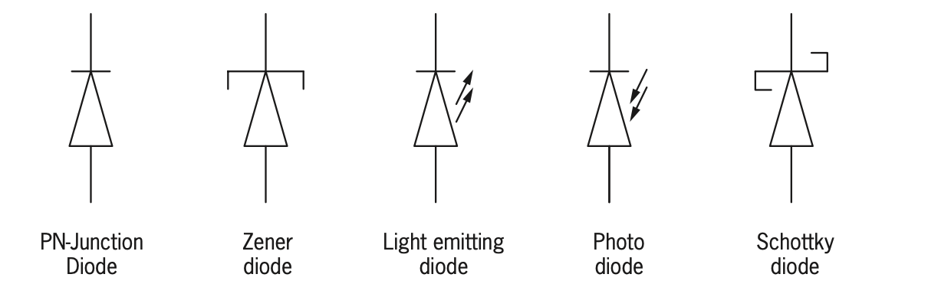
  Module 2: Light current (continued)
DIFFERENT TYPES OF DIODES
Some of the diodes include:
www.futuremanagers.com

Slide 29
  Module 2: Light current (continued)
APPLICATIONS OF SILICON PN-JUNCTION DIODES
Because of its ability to act as a one way valve for electric current flow, the silicon diode is mostly used as a rectifier, allowing current flow when it is forward biased, and blocking current when it is reverse biased. Its ability to conduct relatively large forward currents and to block high reverse voltages, makes it ideal as a rectifier.
www.futuremanagers.com

Slide 30
  Module 2: Light current (continued)
APPLICATIONS OF LIGHT EMITTING DIODES (LEDS)
The first visible red LEDs were mainly used as indicator lamps in the past, but with the development of different colours and high brightness LED’s their applications have multiplied. Infrared LEDs are mainly used in electronic remote-control units. White LEDs are not only replacing incandescent lamps and automotive headlamps, but coloured LEDs are also used in traffic signals, streetlights, camera flashes, cell phones, medical equipment, children’s toys and in advertising boards.
www.futuremanagers.com

Slide 31
  Module 2: Light current (continued)
APPLICATIONS OF PHOTODIODES
As a photodiode produces an electric current when it absorbs light photons, it
is mainly used as a sensor. It can be used in instruments such as light intensity meters, smoke detectors, infrared beam alarms and remote controls. Large area photodiodes are also used to form solar cells used in photovoltaic solar panels, to convert sunlight into an electric current.
www.futuremanagers.com

Slide 32
  Module 2: Light current (continued)
TRANSISTORS AND SILICONE CONTROLLED RECTIFIERS (SCR)
Transistors and SCRs are both three-terminal silicon devices, but with different operating characteristics. Transistors can be controlled after they have been switched on and while they are operating, whereas SCRs cannot be controlled once they once they have been switched on.
www.futuremanagers.com

Slide 33
  Module 2: Light current (continued)
BIASING
Biasing means to apply a fixed DC voltage or current to a terminal of an electronic component in order to establish proper operating conditions for that component.
www.futuremanagers.com

Slide 34
  Module 2: Light current (continued)
METHODS THAT WILL CAUSE A SCR TO CONDUCT ELECTRICITY
When it is forward biased, one of the following conditions may trigger the SCR into conduction:
Forward biasing voltage;
Temperature or thermal triggering;
Sudden voltage rise;
Light triggering; and
Gate triggering.
www.futuremanagers.com

Slide 35
  Module 2: Light current (continued)
CONVENTIONAL CURRENT FLOW
Conventional current refers to the current moving in the same direction as the positive charge flow. The electrons flow in the opposite direction as electron current flow, but are equal in magnitude.
www.futuremanagers.com

Slide 36
  Module 3: Binary logic and Boolean algebra
LOGIC CIRCUITS
Binary logic is a system that works with the binary digits “0” (zero) and “1” (one). Logic circuits are a network of symbols whose functions are manipulations of “0” and “1”, with the outcomes given as a “0” or “1”, depending on the specified function.
www.futuremanagers.com

Slide 37
  Module 3: Binary logic and Boolean algebra (continued)
LOGIC OPERATIONS
Logic operations are defined in terms of the logic functions that are performed. The logic operations can also be drawn as logic gate symbols, usually with two inputs and one output. The operation of a logic function in terms of its inputs and corresponding output can be described by making use of a truth table, consisting of “0” and “1” conditions. A logic function can also be physically realised by making use of an electronic circuit, consisting of switches, diodes and transistors in an “off ” or “on” state.
www.futuremanagers.com

Slide 38
  Module 3: Binary logic and Boolean algebra (continued)
OPERATION OF LOGIC GATES: OR FUNCTION
If one input OR the other, or both have a positive condition (“1”), there will be a positive output (“1”).
The operation of the OR gate is such that when both inputs are 0, the output is 0. If either input is 1, the output is 1. When both inputs are 1, the output is also 1.
www.futuremanagers.com

Slide 39
  Module 3: Binary logic and Boolean algebra (continued)
OPERATION OF LOGIC GATES: AND FUNCTION
One input AND another must have a positive condition (“1”) before there is a positive output (“1”).
The operation of the AND gate is such that when any input is 0, the output is 0. Only if both inputs are 1, the output is 1.
www.futuremanagers.com

Slide 40
  Module 3: Binary logic and Boolean algebra (continued)
OPERATION OF LOGIC GATES: NOT FUNCTION
If the input has a positive condition (“1”), the output is NOT what the input is, it is the opposite or inverse (“0”).
The operation of the NOT gate inverter is such that the output is the opposite
of the input. When the input is 1, the output is 0. When the input is 0, the output is 1.
www.futuremanagers.com

Slide 41
  Module 3: Binary logic and Boolean algebra (continued)
OPERATION OF LOGIC GATES: NOR FUNCTION
The operation of the NOR gate is such that the output of the NOR gate is the opposite of the OR gate. If both inputs are 0, the output is 1. If any input is 1, the output is 0.
www.futuremanagers.com

Slide 42
  Module 3: Binary logic and Boolean algebra (continued)
OPERATION OF LOGIC GATES: NAND FUNCTION
The operation of the NAND gate is such that the output of the NAND gate is the opposite of the AND gate. If any input is 0, the output is 1. If both inputs are 1, the output is 0.
www.futuremanagers.com

Slide 43
  Module 3: Binary logic and Boolean algebra (continued)
BOOLEAN ALGEBRA
Boolean algebra is subject to certain mathematical laws, rules and theorems that provide methods which can be used to simplify and reduce complex expressions to a final expression with the minimum number of terms and variables.
www.futuremanagers.com

Slide 44
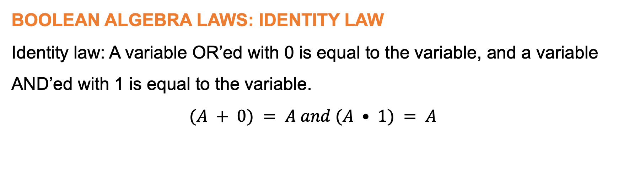
  Module 3: Binary logic and Boolean algebra (continued)
BOOLEAN ALGEBRA LAWS: IDENTITY LAW
Identity law: A variable OR’ed with 0 is equal to the variable, and a variable AND’ed with 1 is equal to the variable.
$$(A + 0) = A and (A • 1) = A$$
www.futuremanagers.com

Slide 45
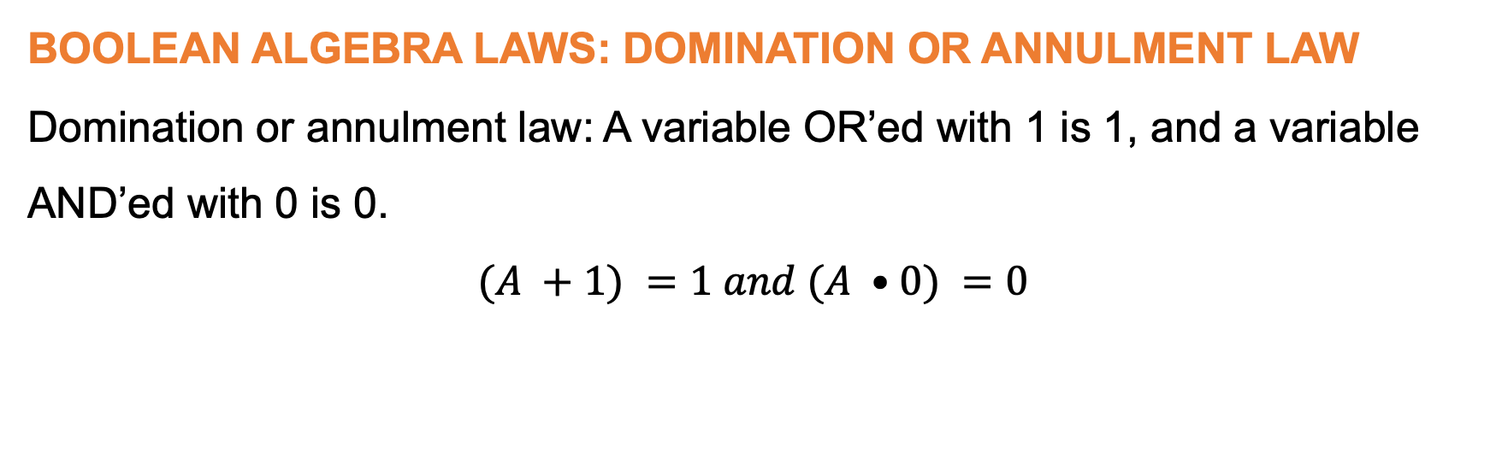
  Module 3: Binary logic and Boolean algebra (continued)
BOOLEAN ALGEBRA LAWS: DOMINATION OR ANNULMENT LAW
Domination or annulment law: A variable OR’ed with 1 is 1, and a variable
AND’ed with 0 is 0.
$$(A +1) =1 and (A •0) =0$$
www.futuremanagers.com

Slide 46
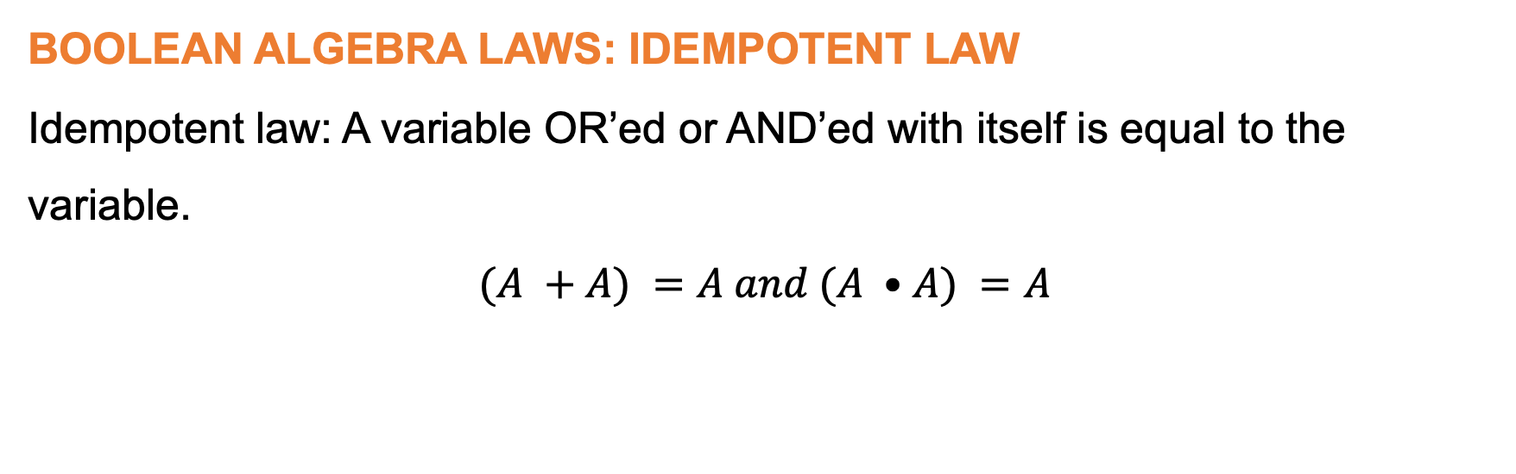
  Module 3: Binary logic and Boolean algebra (continued)
BOOLEAN ALGEBRA LAWS: IDEMPOTENT LAW
Idempotent law: A variable OR’ed or AND’ed with itself is equal to the
variable.
$$(A +A) =A and (A •A) =A$$
www.futuremanagers.com

Slide 47

  Module 3: Binary logic and Boolean algebra (continued)
BOOLEAN ALGEBRA LAWS: INVERSE LAW
Inverse law: A variable OR’ed with its inverse is 1, and a variable AND’ed
ble OR’ed or AND’ed with itself is equal to 0.
$$A(A+A)=1and(A•A)=0$$
www.futuremanagers.com

Slide 48

  Module 3: Binary logic and Boolean algebra (continued)
BOOLEAN ALGEBRA LAWS: COMMUTATIVE LAW
Commutative law: The order in which variables appear does not matter.
$$(A+B)=(B+A)and(A•B)=(B•A)$$
www.futuremanagers.com

Slide 49

  Module 3: Binary logic and Boolean algebra (continued)
BOOLEAN ALGEBRA LAWS: ASSOCIATIVE LAW
Associative law: The order in which variables are OR’ed or AND’ed does not
matter.
$$\left(A+B\right)+C=A+\left(B+C\right) and \left(A•B\right)•C=A•(B•C)$$
www.futuremanagers.com

Slide 50

  Module 3: Binary logic and Boolean algebra (continued)
BOOLEAN ALGEBRA LAWS: DISTRIBUTIVE LAW
Distributive law:
$$A+\left(B•C\right)=\left(A+B\right)•\left(A+C\right) and A•(B+C)=(A•B)+(A•C)$$
www.futuremanagers.com

Slide 51

  Module 3: Binary logic and Boolean algebra (continued)
BOOLEAN ALGEBRA LAWS: ABSORPTION LAW
Absorption law:
$$( A • B ) + ( A • B_ ) = A a n d ( A + B ) • ( A + B_ ) = A$$
$$A + (A • B) = A and A • (A + B) = A \\ A + ( A_ • B ) = A + B and A • ( A_ + B_ ) = A • B$$
www.futuremanagers.com

Slide 52
  Module 3: Binary logic and Boolean algebra (continued)
DE MORGAN’S THEOREMS
De Morgan’s theorems are attributed to the mathematician Augustus De Morgan whose laws and rules allow the Boolean NOR and NAND operations to be split into NOT and OR, and NOT and AND functions respectively. By using the inverted inputs of the variables, an OR function can be changed into an AND function, and an AND function into an OR function.
www.futuremanagers.com

Slide 53
  Module 3: Binary logic and Boolean algebra (continued)
DE MORGAN’S FIRST THEOREM
De Morgan’s first theorem states that when two or more variables are AND and inverted, they are equivalent to the OR function of the inverted inputs.
www.futuremanagers.com

Slide 54
  Module 3: Binary logic and Boolean algebra (continued)
DE MORGAN’S SECOND THEOREM
De Morgan’s second theorem states that when two or more variables are OR and inverted, they are equivalent to the AND function of the inverted inputs.
www.futuremanagers.com

Slide 55
  Module 3: Binary logic and Boolean algebra (continued)
THE BINARY SYSTEM
In the binary number system, the positional values are determined by the exponent of base 2. Digital numbers only have the digits 0 and 1. Each higher position has a value that is double the previous position.
www.futuremanagers.com

Slide 56
  Module 3: Binary logic and Boolean algebra (continued)
BINARY CODED DECIMAL NUMBERS
Binary coded decimal (BCD) is still used extensively in the computer industry today. It is a method to represent the individual digits of a decimal number by their binary equivalents. This is often used in digital displays, where a decimal number has to be displayed by 7-segment display units. For this method every decimal digit is represented by its four digit binary equivalent.
www.futuremanagers.com

Slide 57
  Module 3: Binary logic and Boolean algebra (continued)
TRUTH TABLES
Truth tables are used as a compact method of describing the operation of logic circuits. They can also be used to write a Boolean expression for the operation of the logic circuit. The initial Boolean expression might not be the most simplified version of the Boolean expression.
www.futuremanagers.com

Slide 58
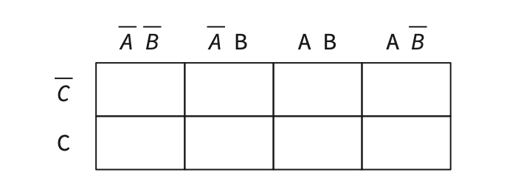
  Module 3: Binary logic and Boolean algebra (continued)
KARNAUGH MAPS
A Karnaugh map is helpful when there are three or more input variables and when the initial Boolean expression has many terms. The Karnaugh map is a table that makes provision for all possible combinations of the input variables.
www.futuremanagers.com

Slide 59
  Module 3: Binary logic and Boolean algebra (continued)
WIRED LOGIC GATES
Wired logic refers to an electronic circuit of a logic gate that implements Boolean algebra logic by using only passive components such as diodes and resistors. Wired logic gates can be used to create Boolean functions such as the AND gate and the OR gate, but it is not possible to form the NOT gate. Logic gates are usually formed by using a voltage source that provides a 5V and a 0V level.
www.futuremanagers.com

