Slide 1

Wholesale and Retail Studies Grade 8

Slide 2
Module 1: The industry
INTRODUCTION
The wholesale and retail industry is dynamic and exciting. When thinking
about retail, most people will immediately think about jobs involving cashiers
operating tills in supermarkets, or sales Assistants helping customers choose
clothing. This is only a part of the world of wholesaling and retailing. This
year, you are going to be introduced to the world of wholesale and retail.
www.futuremanagers.com

Slide 3
Module 1: The industry (continued)
THE CONCEPT AND ROLE OF WHOLESALING AND RETAILING
There is a difference between wholesalers and retailers.
If a customer wants to buy products, he or she would need to get these products from a business known as a retailer.
Small businesses don’t always have space to hold bulk stock; this is where the wholesaler comes in.
A distribution channel is a route along which goods or products travel from the manufacturer to the consumer, through various companies.
www.futuremanagers.com

Slide 4
Module 1: The industry (continued)
CATEGORIES OF RETAILERS
Retailer categories range from independents, small and micro-enterprises, franchise, groups and chains, discounters and convenience store.
Small or large retailers like this all fulfil various roles and functions in the retail space.
www.futuremanagers.com

Slide 5
Module 1: The industry (continued)
SUPPLY CHAINS
The supply chain is the distribution channel along which stock will move from the raw material supplier, to the point where the finished product is bought and taken home to be used by the customer.
The supply chain involves many businesses, people and resources that are involved in the process of converting raw materials into products and ensuring that these products are available to the end user – the retail customer.
www.futuremanagers.com

Slide 6
Module 1: The industry (continued)
SUPPLY CHAINS (CONT.)
In the case of large retail chains, they often have their own distribution centres (DCs). The supplier delivers large quantities to these DCs and the retailer then splits the goods into smaller packs to send to their individual retail branches.
www.futuremanagers.com

Slide 7
Module 1: The industry (continued)
SUPPLY CHAINS (CONT.)
There is a second supply chain that affects this industry, and it is called the cold chain. The cold chain functions just like the supply chain model we’ve examined, except that every item and process is temperature controlled at every stage along the chain.
www.futuremanagers.com

Slide 8
Module 1: The industry (continued)
SUBSECTORS OF THE RETAIL INDUSTRY
The formal sector is made up of small, medium and large organisations. The can be found in shopping malls and stores throughout the country.
The informal sector, consists mainly of what are called micro-enterprises. These are usually very small traders.
www.futuremanagers.com

Slide 9
Module 1: The industry (continued)
SUBSECTORS OF THE RETAIL INDUSTRY (CONT.)
There are also subsectors in the industry. There five main sub-sectors into which all retail businesses are grouped are
  furniture
  CFTA (clothing, footwear, textiles and accessories)
  food
  speciality
  fuel.
www.futuremanagers.com

Slide 10
Module 1: The industry (continued)
JOBS AND PROGRESSION IN THE INDUSTRY
Most people entering the industry do so at the lowest levels, but the wholesale and retail sector holds many opportunities for a fulfilling career. When considering working in this sector, many imagine the PoS operators, shelf packers (merchandisers) or sales assistants, but these are only some of the jobs that are available in this varied industry.
www.futuremanagers.com

Slide 11
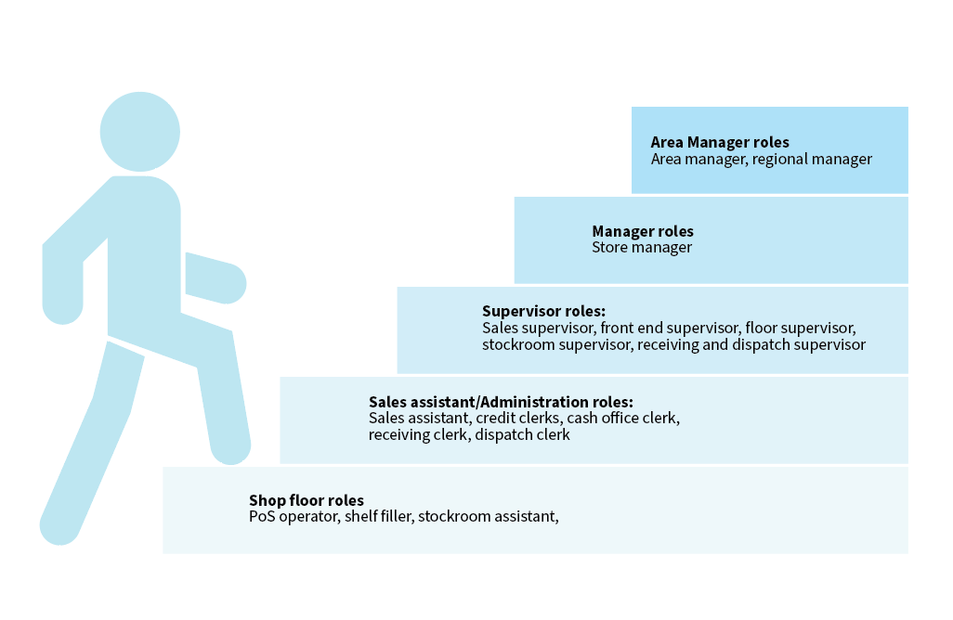
Module 1: The industry (continued)
JOBS AND PROGRESSION IN THE INDUSTRY (CONT.)
www.futuremanagers.com

Slide 12
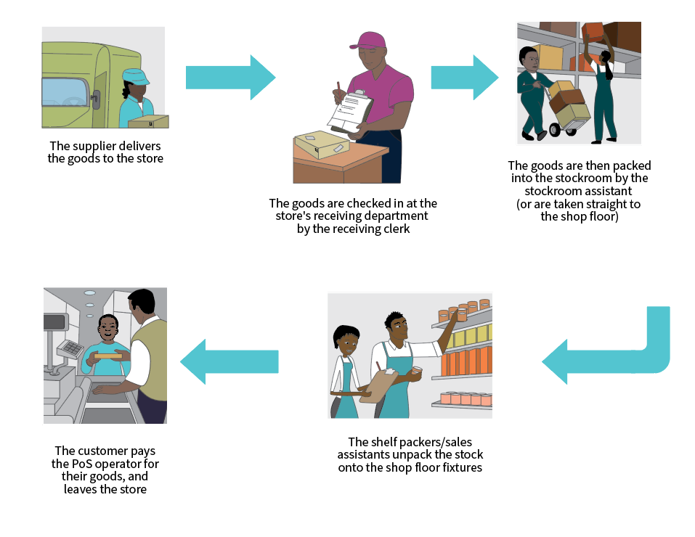
Module 1: The industry (continued)
THE FLOW OF STOCK AND JOBS IN RETAIL STORES
www.futuremanagers.com

Slide 13
Module 1: The industry (continued)
THE ROLE OF EACH ROLE PLAYER IN THIS FLOW (CONT.)
This person is often called the receiving clerk or receiving manager and, in some very big stores or big wholesalers, this job could be separated into a receiving clerk to receive the stock and a separate dispatch clerk to dispatch stock.
In smaller stores, senior staff or the owners in micro-enterprises would usually carry out such tasks, while in bigger, busier stores like supermarkets, there would be one or more people employed specifically to do this job.
www.futuremanagers.com

Slide 14
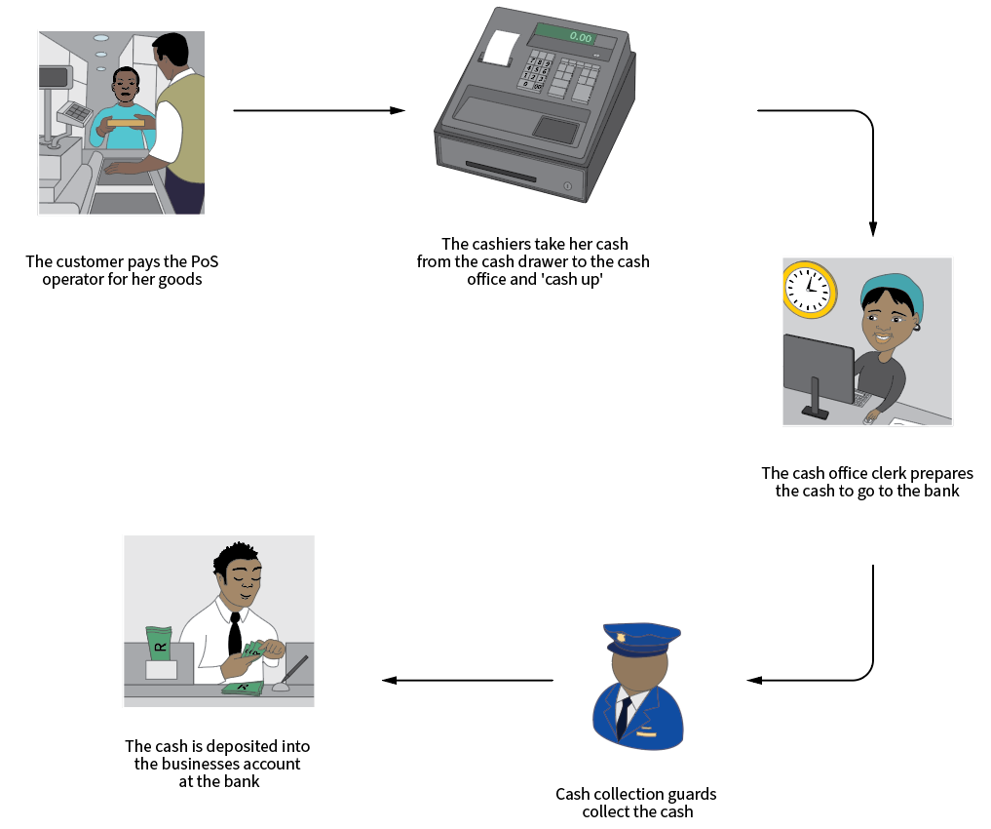
Module 1: The industry (continued)
THE FLOW OF CASH THROUGH AN OUTLET (CONT.)
www.futuremanagers.com

Slide 15
Module 1: The industry (continued)
Computerisation in the industry
Computerisation is the adaptation of information and execution of processes using computers or technology.
It can involve digitisation, which is the use of technology and the internet to adapt information and the execution of processes and operations.
Businesses used to fill in paper documents and send those off to the bank to be processed before the money could go into their bank account. Now this happens within seconds.
www.futuremanagers.com

Slide 16
Module 2: Profit
INTRODUCTION
This module will teach you the principles of profit in the wholesale and retail industry. You will learn how profit is derived from income, how to calculate this and understand the implications of shrinkage, and how it affects business and profit.
www.futuremanagers.com

Slide 17
Module 2: Profit (continued)
THE CONCEPT OF PROFIT
Profit is very important in a business, especially in a wholesale or retail business.
Profit is the amount of money that is generated by the business when it’s sold something for more than it cost the business to purchase it.
www.futuremanagers.com

Slide 18
Module 2: Profit (continued)
CALCULATING PROFIT
The ability to calculate profit in a retail store is also very important because it helps to determine how healthy a business is and whether it is successful or not. In small retail businesses where there is only one shop, the business would use an income statement that would be prepared with the help of an accountant. In large chain stores, a ‘mini’ income statement, called a profit and loss statement or ‘P&L’, is used. It simply shows the figures for that specific store and whether it has made a profit or a loss.
www.futuremanagers.com

Slide 19
Module 2: Profit (continued)
SHRINKAGE
The term shrinkage is used in the wholesale a retail industry to describe a loss of profit through the loss of merchandise or the loss of cash through theft, administrative errors, or stock loss.
A store can make a loss through cash that has disappeared or when customers are charged less for a product than they should be. Loss can also occur when damaged stock can’t be returned to the supplier.
www.futuremanagers.com

Slide 20
Module 3: Target markets
IDENTIFYING TARGET MARKETS
All consumers are different, but sometimes they have similar characteristics and needs, and are interested in similar products. When we group them together according to these characteristics, they become a target market.
www.futuremanagers.com

Slide 21
Module 3: Target markets (continued)
UNDERSTANDING CUSTOMER PROFILES
A customer profile is a detailed description of a target market (group of of customers), describing certain specific characteristics that they may have in common.
Researchers can gather information in person where they talk to people in public places (like shopping centre parking lots) and ask the people specific questions to gain information. They may also phone or send electronic surveys via email or on the internet.
www.futuremanagers.com

Slide 22
Module 3: Target markets (continued)
CUSTOMER PROFILES AFFECTING A BUSINESS’S PRODUCT RANGE AND SERVICE
Customer profile variables have an impact on the product range that a retail store will offer, and it will affect the following:
• product pricing
• product variety or range
• product quality; and
• the quantity of product available.
www.futuremanagers.com

Slide 23
Module 4: Customer service
INTRODUCTION
Customer service is the concept that describes how a customer is treated or how they experience the way they are treated when they choose to buy products or services from a business.
www.futuremanagers.com

Slide 24
Module 4: Customer service (continued)
LEVELS OF CUSTOMER SERVICE IN THE LOCAL RETAIL INDUSTRY
The level of customer service isn’t about how good or how bad the service is. Rather, it relates to how much attention the retail store staff provides when assisting customers in making their decisions to buy a product.
www.futuremanagers.com

Slide 25
Module 4: Customer service (continued)
THE IMPORTANCE OF CUSTOMER SERVICE AND THE IMPACT ON GOOD OR BAD SERVICE
It’s worth remembering that the only person who can rate the service experience of a store is not the sales assistant or the sales advisor or even the retail store manager, but the customer!
The impact is loss of sales which impacts the profit.
www.futuremanagers.com

Slide 26
Module 4: Customer service (continued)
CUSTOMER SERVICE AND ONLINE SHOPPING
The use of the internet for shopping has increased over the years as customers use computers as well as apps (applications) on their cell phones to make purchases. Online shopping is also called e-commerce.
Here customer service could mean efficiency of delivery, responses to queries and an easy-to-use website or app.
www.futuremanagers.com

Slide 27
Module 4: Customer service (continued)
SHOPPING PATTERNS AND CUSTOMER SERVICE
In the retail industry, research is done to find out how customers shop by observing the way they shop.
Shopping patterns or buying behaviour refers to why and how customers shop the way they do.
www.futuremanagers.com

Slide 28
Module 5: Stock
INTRODUCTION
A business that can control their levels of stock can control the amount of capital it needs to put into the business. There must be enough stock so that stock is always available for the customer, but not so much stock that it sits in the shop for a long time.
www.futuremanagers.com

Slide 29
Module 5: Stock (continued)
THE IMPACT OF STOCK ON CUSTOMERS, BUSINESS FINANCES, AND SHRINKAGE AND WASTAGE
Buying too much stock or ordering the wrong kinds of products, stock that sits on your shelves and does not sell, ties up your money – your capital. In this section we’ll look deeper and understand how customers and fi nances are affected.
www.futuremanagers.com

Slide 30
Module 5: Stock (continued)
PERPETUAL INVENTORY
In this industry, when we talk about perpetual inventory, it means knowing at all times what stock is on hand in the business for each and every product stocked. This is only possible in a business that is organised and technologically advanced enough and uses computer systems that record transactions at all stages in the business (when stock is ordered, when it is received, when it is discounted, when it is sold or refunded).
www.futuremanagers.com

Slide 31
Module 5: Stock (continued)
REASONS OUTLETS COUNT STOCK
Outlets count stock in order to:
Improve accuracy when ordering
Maintain up-to-date perpetual inventory balances
Have better organisation for stock-taking and auditing
www.futuremanagers.com

Slide 32
Module 6: Merchandising
INTRODUCTION
Merchandising is a term used specifically in the retail industry. This module will underline the important role of merchandising and its impact on retailers.
www.futuremanagers.com

Slide 33
Module 6: Merchandising (continued)
THE CONCEPT AND OBJECTIVES OF MERCHANDISING
Merchandising can be defined as follows:
• Promoting the sale of goods, especially by their presentation, in retail outlets.
• It is the placing of goods together according to their use to encourage multiple purchases.
www.futuremanagers.com

Slide 34
Module 6: Merchandising (continued)
THE DIFFERENCE IN MERCHANDISING TECHNIQUES BETWEEN WHOLESALERS AND RETAILERS
Customers from different target markets shop differently and expect different things from a store. This also influences the way would merchandise differently depending on your intended shopper and the LSM category they would fall into. The person in LSM 10 and the shopper in LSM 3 have different needs and spending power, and different things will appeal to each one.
www.futuremanagers.com

Slide 35
Module 6: Merchandising (continued)
MERCHANDISING FIXTURES AND FITTINGS
Fixtures and fittings are permanent or semi-permanent props, tools and furniture that are fitted or attached in a location.
This includes different kinds of gondolas, bins and baskets, promotional stands, specialised shelving and fridges amongst others.
www.futuremanagers.com

Slide 36
Module 6: Merchandising (continued)
MERCHANDISING METHODS
Merchandising is done differently depending on whether there are high-value items that need extra security or whether there’s lots of stock to move that consumers want to find easily.
www.futuremanagers.com

Slide 37
Module 6: Merchandising (continued)
DIFFERENT PRICING METHODS
Most stores that sell to the ordinary consumer with an ordinary or limited amount to spend will ensure that every item has a price available, because these retailers know that unpriced items will not sell.
The way pricing is presented depends on the store or clientele the business hopes to attract.
www.futuremanagers.com

Slide 38
Module 7: Recording sales
INTRODUCTION
Here you’ll get to know how to record sales, process payments, cash up tills and to bank takings
www.futuremanagers.com

Slide 39
Module 7: Recording sales (continued)
METHODS OF RECORDING SALES
The methods used in spaza shops are very different from the processes in large national chains. There are computerised as well as non-computerised methods for recording sales, including recording sales in both formal and informal stores.
www.futuremanagers.com

Slide 40
Module 7: Recording sales (continued)
POS EQUIPMENT AND COMPONENTS
There are computerised and non-computerised methods or PoS systems and equipment.
Some stores have PoS systems that work without the cashier needing to open the drawer to give the customer the change. It all happens automatically.
www.futuremanagers.com

Slide 41
Module 7: Recording sales (continued)
THE ROLE OF THE CASHIER IN RECORDING SALES
Working on a PoS – that is both recording sales and accepting and processing payment, is a very important job. Cashiers are responsible for thousands of rands passing through the retail store every day, and for recording every item sold accurately.
www.futuremanagers.com

Slide 42
Module 7: Recording sales (continued)
ACCEPTABLE FORMS OF PAYMENT
There are many different forms of payment (types of tender) a customer can use to pay for goods purchased.
This ranges from cash and card payments, EFTs, store credit arrangements, vouchers and digital or e-Wallet payments through apps or QR codes.
These all have different processing requirements or steps to ensure successful payment of goods.
www.futuremanagers.com

