Slide 1


Bricklaying and Plastering Theory
N1

Slide 2
Module 1: Personal safety on site (PPE)
INTRODUCTION
Wherever a bricklayer and plasterer works, he must take care of his own safety and that of his fellow men around him. It is an established fact that many accidents occur due to negligence, or ignoring the prescribed regulations as posted on signposts, billboards etc, or not following the operating instructions of the company. Bricklaying and plastering is one of the most well-known trades in the country, also known as the “wet” trades.
www.futuremanagers.com

Slide 3
Module 1: Personal safety on site (PPE) (continued)
PERSONAL PROTECTIVE EQUIPMENT (KNOWN AS PPE)
These are essential to be on site:
www.futuremanagers.com

Slide 4
Module 1: Personal safety on site (PPE) (continued)
THE EMPLOYER
The employer, occupier or user shall provide free of charge, and maintain in good conditions adequate protective clothing and appliances, including, where necessary, overalls, footwear, gloves, hard hats, goggles, protective ointment, and so on, to any person working in his/her employment.
www.futuremanagers.com

Slide 5
Module 1: Personal safety on site (PPE) (continued)
OVERALLS
Any form of work is labour intensive, with the result that the body needs to be protected against any exterior mishaps. When wearing a well-designed overall for a specific task to protect the body, see to it that it is clean and fits properly. A shabby outfit can spoil the image of yourself and the name of the company which you represent.
www.futuremanagers.com

Slide 6
Module 1: Personal safety on site (PPE) (continued)
FOOTWEAR
Footwear is very important. Footwear may protect your feet against skidding on a slippery floor or in muddy areas where building operations are in progress. Care must also be taken not to wear footwear with nails where petroleum or explosive works are.
www.futuremanagers.com

Slide 7
Module 1: Personal safety on site (PPE) (continued)
GLOVES
Your hands are tools to assist you in carrying out a specific job; therefore, do not risk your hands and fingers by handling any loose, splintered scaffold boards or wet steel tubular scaffold equipment or similar dangerous objects without gloves.
www.futuremanagers.com

Slide 8
Module 1: Personal safety on site (PPE) (continued)
HARD HATS
A hard hat is prescribed by most building, civil, and allied groups to be worn on a construction site. Failing this requirement, can bring about heavy penalties for those who do not abide by the regulations, as prescribed by the safety and health Acts. Different coloured hats can help identify different jobs and positions on site.
www.futuremanagers.com

Slide 9
Module 2: Safe handling of equipment
SAFE HANDLING AND PREPARATION OF EQUIPMENT
All steel trestles must be properly stacked while not in use. When scaffold boards need to be moved from the yard storage, make sure you have an assistant to help carry the long boards to their destination. All wheelbarrows must be parked nose down at night-time and properly chained together to avoid any losses. Aluminium step-ladders must have proper rubber inserts at the bottom to secure a steady platform. Fibre-type ladders must be checked daily to see if any stiles are damaged.
www.futuremanagers.com

Slide 10
Module 3: Site establishment
SHEERLEGS
After accepting the proposed approved plan, the contractor needs to visit the site for inspection. The contractor needs to look at necessary requirements:
Site planning, where to erect huts and offload materials.
Is the site accessible from the street?
Is the ground suitable, clay, waterlogged, sloping?
Available labour force in the area.
Type of plant and equipment needed.
Suppliers of material.
Travelling time to and fro.
Is the site situated close to a busy street?
Availability of water.
Telephone connection.
Weather conditions during the contract period.
www.futuremanagers.com

Slide 11
Module 4: Good housekeeping
GOOD HOUSEKEEPING
Good housekeeping ensures a safe environment for all production teams on site. Proper billboards must be displayed with all relevant safety requirements to abide by. Furthermore, provide clean, hygienic facilities for construction teams during tea breaks and lunch hours. During windy seasons, all types of sand must be kept closed with tarpaulins or large PVC sheeting to avoid any health hazards on site. All access roads to the site must be kept in a proper condition for delivery truck.
www.futuremanagers.com

Slide 12
Module 5: Tools
INTRODUCTION
The tools of a bricklayer and plasterer can be divided into four main categories:
Tools used when working with mortar.
Tools used for measuring.
Tools that determine whether the work is level, square or straight.
Tools used for splitting, dressing or shaping bricks/stone.
www.futuremanagers.com

Slide 13
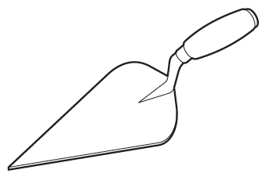
Module 5: Tools (continued)
BRICKLAYER’S TOOLS
Different types of tools for bricklaying include:
The trowel;
The Frenchman knife;
Levels, such as the spirit or boat level;
Plumb-bob;
Hammers;
Chisels;
Screwdrivers;
Measuring tools;
Try squares;
Boning rods;
Profiles;
Boesmans or clamps;
The line peg;
The corner block;
The tingle; and
Trammels.
www.futuremanagers.com

Slide 14
Module 5: Tools (continued)
PLASTERING TOOLS
Different types of tools for plastering include:
Plastering trowels;
Hawk or mortar board;
Corner trowels;
Block brush;
Paint brushes;
Jointers;
Cove trowel (mould);
Straight edge; and
Spades.
www.futuremanagers.com

Slide 15
Module 5: Tools (continued)
THE STONEMASON
Different types of tools include:
Hammers;
Chisels;
Splitting wedges;
Crowbars;
Claw hammer;
Air compressor;
Jackhammer;
Electric angle grinder;
Wheelbarrow;
Concrete mixer;
Trestles;
Scaffold boards; and
Ladders.
www.futuremanagers.com

Slide 16
Module 5: Tools (continued)
TILING TOOLS
Different types of tools for tiling include:
Tile cutters;
Tile spacers;
A tile nippers;
Notch trowels;
Metal spreaders;
Pincers; and
V-shaped tile drill bit.
www.futuremanagers.com

Slide 17
Module 5: Tools (continued)
TOOL MAINTENANCE
Taking care of tools is crucial to maintaining a long-lasting quality for a workman’s equipment. Some important rules for tools are:
Hand tools: Should be wiped clean, sharpened and greased.
Electric tools: Should be properly insulated and not be used in inclement weather or near flammable goods.
Site plant: Equipment should be thoroughly looked after and care should be taken when and where it used.
www.futuremanagers.com

Slide 18
Module 6: Aggregates
DEFINITION
An aggregate is a substance that is mixed with a binder (cement) and a liquid (water) to produce synthetic rock called concrete. Materials that are used for this purpose include sand, gravel, crushed stone, crushed blast-furnace slag and expanded vermiculite, pearlite or Styrofoam pellets or grains.
www.futuremanagers.com

Slide 19
Module 6: Aggregates (continued)
TYPES OF AGGREGATES
Aggregates can be divided into two main groups: those used to produce high-density concrete (sand and stone) and those used for low-density concrete. Sand can be obtained from a natural source, such as excavation from a river bed, or manufactured from crusher run material. Stone is the common term for the coarser parts of an aggregate and is taken as any particle larger than 4,75 mm.
www.futuremanagers.com

Slide 20
Module 6: Aggregates (continued)
LOW-DENSITY AGGREGATES
Clinker is boiler ash obtained from power stations.
Foamed slag is formed when slag derived from blast furnaces is cooled rapidly by spraying water on it.
Vermiculite lowers the thermal conductivity of concrete.
Polystyrene helps provide bulk without increasing mass. It is a common packaging material.
www.futuremanagers.com

Slide 21
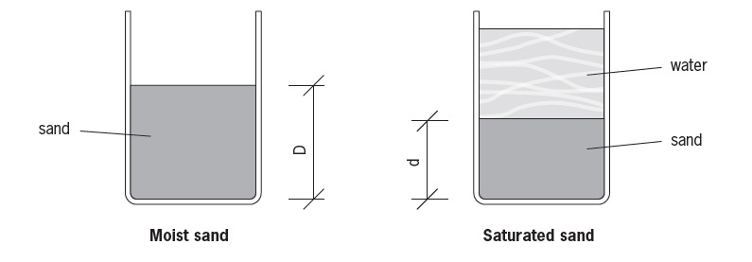
Module 6: Aggregates (continued)
BULKING OR MOISTURE EXPANSION OF SAND
An important property of an aggregate is that its volume varies according to its moisture content. If an accurate bulking factor of the specific sand batch is not available, it must be assumed to be 25% per the batch volume and 5% of the mass volume.
www.futuremanagers.com

Slide 22
Module 6: Aggregates (continued)
COMPACTING CONCRETE
Compacting concrete mixes should occur as soon as possible after it has been mixed and placed. Compacting by means of vibration may reduce the workability of concrete by segregating the components, which manual compacting does not do.
www.futuremanagers.com

Slide 23
Module 6: Aggregates (continued)
CURING
Concrete cures due to a chemical reaction between the water and cement in the mixture. The reaction begins as soon as water is added and only stops once all the cement has been fully hydrated, which may be only years later for concrete to reach its full strength. It is necessary to ensure that it contains sufficient water for the chemical process to be completed.
www.futuremanagers.com

Slide 24
Module 7: Cements
ORDINARY PORTLAND CEMENT
Cement was patented in 1824 by Joseph Aspdin, who called it Portland due to its colour. The main ingredients of cement are chalk and clay. Different types of cement include:
Ordinary Portland cement;
Rapid-hardening cement;
Portland blast furnace cement;
Sulphate-resisting Portland cement;
Special Portland cements.
www.futuremanagers.com

Slide 25
Module 8: Low-density concrete
INTRODUCTION
Low-density concrete is that with a density below 1 900 kg/ m³. The special properties of no-fines concrete are that it shrinks very little during hardening or curing (50% less than ordinary concrete) and offers exceptional resistance against the penetration of moisture when used for sublevel floors and exterior walls.
www.futuremanagers.com

Slide 26
Module 8: Low-density concrete (continued)
ACCELERATORS
Accelerators are used where it is necessary to reduce the setting time of concrete. They are used for the following applications:
To counteract the effects of cold weather.
Formwork can be removed sooner.
The concrete can be subjected to loads sooner.
www.futuremanagers.com

Slide 27
Module 8: Low-density concrete (continued)
RETARDERS
Retarders are used to slow the initial setting rate and are primarily used in hot weather when concrete is inclined to set too quickly for proper hydration. The admixtures extend the hydration period and more water is retained as a result. The concrete remains workable for a longer period, allowing it to be placed and finished while still plastic.
www.futuremanagers.com

Slide 28
Module 8: Low-density concrete (continued)
COLOURED CONCRETE
The following are colour-cretes most commonly used for concrete:
Pigments;
Chemical colourants; and
Paints.
www.futuremanagers.com

Slide 29
Module 8: Low-density concrete (continued)
LIME
Lime can be divided into the following categories:
Rich or hot (calcium) lime;
Cold lime;
Hydraulic lime;
Dolomite (calcium-magnesium lime); and
Hydrated/slaked lime and unslaked/quicklime.
www.futuremanagers.com

Slide 30
Module 9: Concrete
INTRODUCTION
Concrete is an artificially manufactured stone comprising of cement: sand: stone. Concrete plays an important role as the foundation of structures such as for houses, factories, shopping centres, hospitals, fire stations, bridges and reservoirs. Generally speaking, concrete can be divided into dense concrete and low-density concrete.
www.futuremanagers.com

Slide 31
Module 9: Concrete (continued)
CLASSIFICATION AND USES
Concrete mix ratios and the size of the aggregate determine the strength of the concrete for a particular component in the concrete structure. The different strength will determine what the concrete is used for.
www.futuremanagers.com

Slide 32
Module 9: Concrete (continued)
CONCRETE TESTS
The slump test is used to determine the workability of a specific mix design on site.
The compaction factor test can only be conducted in a laboratory and is especially useful in the manufacturing of precast concrete units.
Test cubes are used to make samples of a batch.
Tensile tests are done by mixing cement with sand to form a mortar paste, ratio of 1 : 3 with a specified amount of water.
www.futuremanagers.com

Slide 33
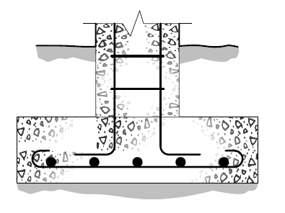
Module 9: Concrete (continued)
STEEL REINFORCEMENT IN CONCRETE
Reinforcing steel is the structural material used most commonly in civil engineering. There are different types of steel reinforcements:
Mild steel;
Bending steel;
Carbon fibre strips; and
High-tensile steel reinforcement and concrete coverage.
www.futuremanagers.com

Slide 34
Module 10: Levelling with instruments
LEVELLING
Before any levelling can take place, the contractor needs to clean the site of all vegetation, loose stones or any other loose or fixed items which may obstruct the setting out of the building.
www.futuremanagers.com

Slide 35
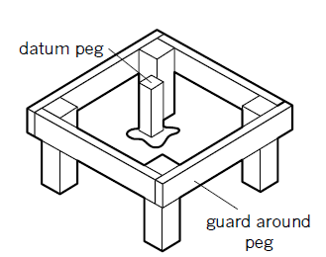
Module 10: Levelling with instruments (continued)
DATUM LEVELS
Levelling can only take place if the official boundary pegs are available. All street datum levels are obtainable from the local town/city engineer’s department for reference purposes. The site surveyor will establish a datum peg on the site. All reference work will be relayed from this point, such as foundation depths, floor levels.
www.futuremanagers.com

Slide 36
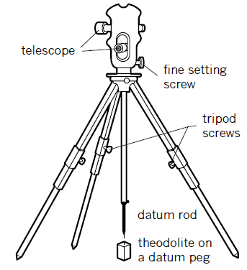
Module 10: Levelling with instruments (continued)
THE THEODOLITE
The theodolite is a very useful instrument to determine if the ground is level and if any of the foundation bottoms need to be stepped. Foundation excavation levels could also be easily determined with the theodolite.
www.futuremanagers.com

Slide 37
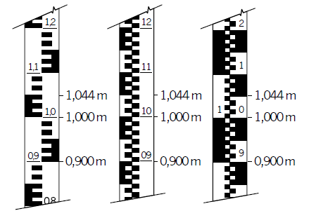
Module 10: Levelling with instruments (continued)
SURVEY STAFF
The two on the left are the most used on the site. They are known as the “E”-pattern staffs. Each block represents 10 mm. A full “E” equals 50 mm. This makes figure recording easy from a distance by the surveyor.
www.futuremanagers.com

Slide 38
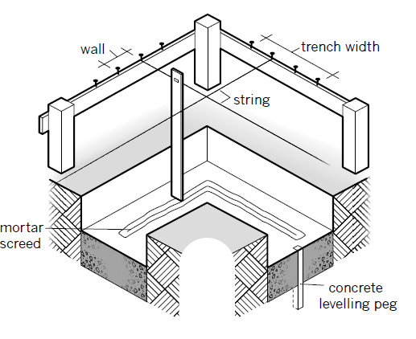
Module 10: Levelling with instruments (continued)
PROFILES
Trench profiles are needed for excavation purposes. The crossbar at each corner profile also indicates to the concreter the width of the foundation, the thickness to the bricklayer and at which point where to start, etc.
www.futuremanagers.com

Slide 39
Module 11: Foundations
FUNCTION OF THE FOUNDATION
The foundation is the base on which an entire building construction or superstructure rests. Concrete foundations, irrespective of type, are primarily cast in trenches to distribute the load placed upon them evenly and to anchor the structure in firm ground.
www.futuremanagers.com

Slide 40
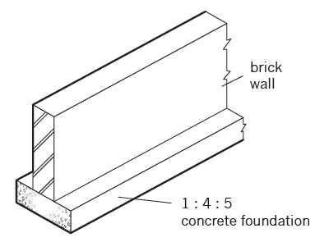
Module 11: Foundations (continued)
TYPES OF FOUNDATIONS
Mass strip foundations on which houses are built;
Reinforced strip foundations helps to support and suit heavier loads; and
Pile foundations are similar to concrete columns.
www.futuremanagers.com

Slide 41
Module 11: Foundations (continued)
FOUNDATION STEPS
Foundations are generally not level across a sloping area, but are cast in sections and referred to as a stepped foundation. The rise of each step should be at least three brick courses, and under each step the foundation is strengthened by increasing the thickness of the next section to 450 mm.
www.futuremanagers.com

Slide 42
Module 11: Foundations (continued)
CONCRETE BLINDING
This refers to a layer of dense concrete, cast over the entire surface of a building. It should be at least 150 mm thick and placed below ground level to seal the entire building and prevent rising damp or moisture.
www.futuremanagers.com

Slide 43
Module 11: Foundations (continued)
FOUNDATION WALL
The brickwork from foundation to floor level is referred to as the substructure. According to local regulations, floor levels must be at least 150 mm above the natural ground level surrounding the building. When suspended floors are used, the minimum height of the foundation walls must be 450 mm in order to make provision for ventilation. The brick footing course forms part of the foundation.
www.futuremanagers.com

Slide 44
Module 11: Foundations (continued)
FOUNDATION PLINTH
This provides a solid base for the main wall and is always wider than the wall itself.
It serves as a damp-proofing barrier that prevents moisture from seeping under the building from surrounding soil.
It is designed to bear solid concrete as well as timber suspended floors.
www.futuremanagers.com

Slide 45
Module 11: Foundations (continued)
SLEEPER PIERS AND SLEEPER WALL
When timber floors are laid, the floor joists need to be supported by sleeper piers. Square piers or pillars are built for this purpose. Whenever the room width or length is very wide, a sleeper wall with foundations is cast instead of piers. Sleeper walls are normally built with gaps and provided with a reasonable hole along for an artisan to crawl through to do maintenance work or to get rid of unwanted swarms of bees.
www.futuremanagers.com

Slide 46
Module 11: Foundations (continued)
ANT GUARDS
Ant guards are fixed to the inside of exterior walls, as well as around the piers and sides of the sleeper wall. Ant guards are made of 2 mm galvanised sheets, approximately 40 mm in a bent section, which is built in between the brickwork. Any ants/termites coming from the soil below the building cannot get around the ant guard.
www.futuremanagers.com

Slide 47
Module 12: Waterproofing
INTRODUCTION
The purpose of damp-proofing, also known as waterproofing, is to prevent moisture from penetrating buildings, water from escaping reservoirs, sealing of structures against seepage of water into concrete bridges, tunnels and brick walls.
www.futuremanagers.com

Slide 48
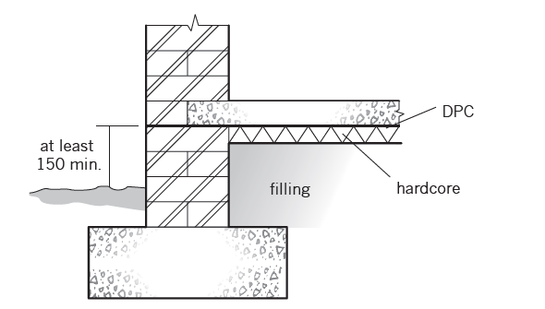
Module 12: Waterproofing (continued)
DPC AT FOUNDATIONS
The risk of having any dampness above DPC foundation level causes timber floors to rot, floor coverings to lift and paint to peel from walls.
www.futuremanagers.com

Slide 49
Module 12: Waterproofing (continued)
WEATHER DRIP AT DOORS, WINDOW-SILLS
The necessary care must be taken to brick-in a reliable type of DPC underneath all window-sills to counteract any water seepage to the interior. A brass weather bar is normally inserted into the sill to prevent rainwater from blowing in.
www.futuremanagers.com

Slide 50
Module 12: Waterproofing (continued)
ROOF CEILINGS
Long-span, flat-slope roofs (less than 10°), such as IBR- and corrugated iron sheeting, tend to cause severe stains to ceiling materials below, due to trickling water drops (vapour) from above during winter months. To avoid this, ceilings such as Rhino board and knotty pine need to have a proper waterproof underlay membrane or isolation material to counteract this problem above the ceilings.
www.futuremanagers.com

Slide 51
Module 12: Waterproofing (continued)
LEAKING ROOF GUTTERS
A leaking gutter, without a fascia board, is another form of wetting the outside walls by penetrating mortar joints during inclement weather conditions.
www.futuremanagers.com

Slide 52
Module 12: Waterproofing (continued)
LEAKING GARDEN TAPS AND SEWERAGE LINES
Both of these are sometimes overlooked whenever a damp situation arises close to the foundation walls. The seepage to floor slabs and walls causes walls to crack and foundation corners to sag, etc. A good sign is when brick walls at corners tend to crack at an angle of 45° upwards.
www.futuremanagers.com

Slide 53
Module 12: Waterproofing (continued)
ROOFS
Damaged membrane sealants allow moisture to penetrate the roof with disastrous consequences. For decades, traditional materials such as paints, malthoid, epoxies, fibreglass, vinyl and polyurea have been used as waterproofing solutions to counteract seepage. From experience, it is proved that most of these problems are related to poor design factors of the roof slope and not proper sealing off projections or abutments, such as parapet and chimney flashings, etc.
www.futuremanagers.com

Slide 54
Module 12: Waterproofing (continued)
TANKING
Tanking is a method of damp-proofing a basement. The layer of waterproofing between the concrete foundation and the subfloor must be carefully linked to the vertical layer, which is plastered onto the interior of the wall. In this way, water cannot penetrate the building from below or from the sides.
www.futuremanagers.com

Slide 55
Module 13: Brick courses
INTRODUCTION
The word “brick” describes a rectangular block of clay that has been baked to form a durable, homogenous unit. When bricks are laid in courses with mortar to bind them, they form strong units that can carry large loads. The art of brickwork lies in using mortar to join a number of bricks in various kinds of overlapping patterns in layers to form homogenous units that can carry large loads without disintegrating.
www.futuremanagers.com

Slide 56
Module 13: Brick courses (continued)
TECHNICAL TERMS
Bed: The under-surface of a brick that rests on the layer of mortar.
Brickbat: Any part of a brick that is cut or broken lengthwise. It can be a half-brick, quarter-brick, etc.
Stretcher: A brick with its 220 × 75 mm side horizontal and its face parallel to the wall face.
Header: A brick with its 110 × 75 mm head parallel to the wall face.
Frog: A depression or hole in the broad surface of the brick.
www.futuremanagers.com

Slide 57
Module 13: Brick courses (continued)
BONDING
Bonding refers to the practice of laying bricks to overlap in such a way that no vertical joint coincides or aligns in any two consecutive courses. The overlaps should be as large as possible but never less than a quarter of the brick length. There are different methods of bonding, such as stretcher bonds, header bonds, English bonds, and Flemish bonds.
www.futuremanagers.com

Slide 58
Module 13: Brick courses (continued)
WALL WITH CORNERS AND JUNCTIONS
Most buildings, except round ones, have corners where bonding becomes problematic. To draw the corners, two lines are drawn at a right angle. The corner brick is marked and the outlines marked accordingly. The corner laid in English bond shows clearly that a queen closer is ALWAYS laid adjacent to the quoin. If there is a stopped end, another queen closer will be laid in order to preserve the bond up to where the wall terminates at the top.
www.futuremanagers.com

Slide 59
Module 13: Brick courses (continued)
BUTTRESSES
A buttress, also known as attached piers, is built to strengthen the wall. Sometimes it is cast in concrete, in which case it is tapered to the top.
www.futuremanagers.com

Slide 60
Module 13: Brick courses (continued)
JOINTING AND POINTING
The finishing of joints between bricks while brickwork is in progress is called jointing. Pointing refers to the finishing of joints of existing walls, but these joints are scraped out and filled with mortar.
www.futuremanagers.com

Slide 61
Module 13: Brick courses (continued)
THE FUNCTION OF WALLS
Walls are in place to give privacy, insulate, and protect people and their belongings against any harsh weather conditions or other strange elements.
www.futuremanagers.com

Slide 62
Module 13: Brick courses (continued)
EXTERIOR INFLUENCES
Resistance to dampness is necessary to prevent serious defects in a building.
Thermal insulation serves many purposes, such as preventing heat loss in a building. Proper insulation ensures comfort and prevents any unnecessary condensation inside the building. Sound insulation helps to absorb noise and assist with sound reduction. Fire resistance is a necessary safety precaution.
www.futuremanagers.com

Slide 63
Module 13: Brick courses (continued)
MANUFACTURING CLAY BRICKS
Bricks are popular for domestic construction work as they are available in a variety of colours and finishes to cater for different tastes. Different types of bricks include:
Common stock bricks;
Face bricks; and
Efflorescence.
www.futuremanagers.com

Slide 64
Module 13: Brick courses (continued)
MANUFACTURING OF FIRECLAY BRICKS
Firebricks or refractory bricks are manufactured to withstand extreme heat, hence, the laying and manufacturing processes differ from those used for common bricks.
www.futuremanagers.com

Slide 65
Module 13: Brick courses (continued)
CONCRETE HOLLOW BLOCK MAKING
A variety of materials could be used as aggregates for block making. The choice of material will depend on the type of block that is required. It is essential to do the necessary research to choose the correct material. The most commonly used aggregate for block making consists of hard, durable, clean river sand with cement.
www.futuremanagers.com

Slide 66
Module 13: Brick courses (continued)
PLASTERWORK
The main function of plaster is to provide water resistance and also decorate the wall, when painted with different colour schemes. Plastering refers to the mixture of cement and plastering sand or other material that is applied to the surface of the wall to provide a neat, waterproof finish.
www.futuremanagers.com

Slide 67
Module 14: Arches
CLASSIFICATION OF ARCHES
Common bricks are used in the construction of rough arches, i.e. the arch will be plastered. Specially cut or tapered voussoirs or tapered face bricks are used in the construction of gauged arches.
www.futuremanagers.com

Slide 68
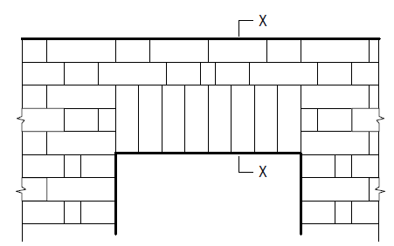
Module 14: Arches (continued)
SOLDIER-BRICK ARCHES
Soldier-brick arches are actually lintels that are constructed using bricks laid on end in soldier course with a stretcher face (110 mm × 75 mm) showing.
www.futuremanagers.com

Slide 69
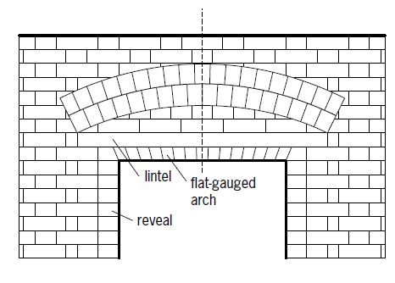
Module 14: Arches (continued)
FLAT-GAUGE ARCH
The flat-gauge arch is made of rubbed (shaped) bricks or custom-made bricks roughly shaped to fit the arch.
www.futuremanagers.com

Slide 70
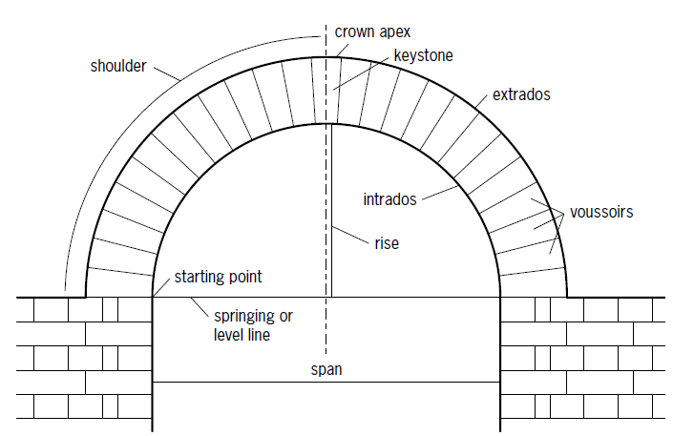
Module 14: Arches (continued)
SEMICIRCULAR ARCH
www.futuremanagers.com

Slide 71
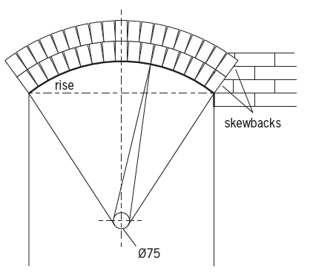
Module 14: Arches (continued)
SEGMENTAL ARCH
www.futuremanagers.com

Slide 72
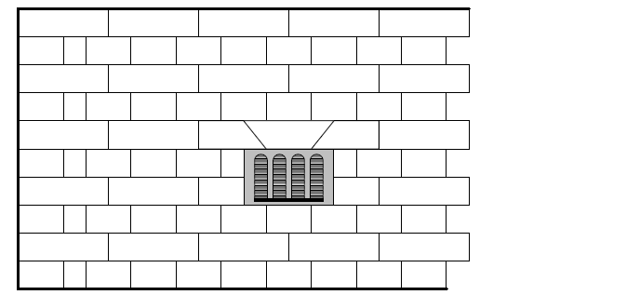
Module 14: Arches (continued)
ARCHES ABOVE AIR-BRICKS ARCH
Air-bricks or ventilators are built in to circulate air underneath timber suspended floors. Care must, however, be taken that the air-brick is not built in upside down upon the DPC layer.
www.futuremanagers.com

Slide 73
Module 15: Economics
PRODUCTIVITY
Productivity is based on a team effort. If all goods are delivered as required on time, and work progresses as planned according to the bar chart, with no bad weather conditions or negative influences from other sources, the project could be handed over on time.
www.futuremanagers.com

Slide 74
Module 15: Economics (continued)
PROFIT
To establish a company, it needs large capital investment to get it off the ground. The labour force should be productive to ensure a good turnover to bring about a flourishing company in years to come. The first objective should be to have a good bookkeeping system and an experienced estimator for quotation purposes, otherwise the company may go insolvent.
www.futuremanagers.com

Slide 75
Module 15: Economics (continued)
LOSS
Loss can be attributed to many factors, even if the company employs the best accountant in charge of the auditing system. Factors that may influence shortfalls or losses are:
Labour force;
Theft;
Strikes;
Market conditions;
Weather conditions;
Stock exchange fluctuations; and
Company estimates.
www.futuremanagers.com

Slide 76
Module 16: Masonry
INTRODUCTION
Masonry refers to the use of rock or stone to construct walls and other structures. Natural stone or artificial (cast) stone can be used. Natural stone can be used in its natural form or cut and/or dressed into more regular blocks.
www.futuremanagers.com

Slide 77
Module 16: Masonry (continued)
MOULDINGS
Mouldings are used in bricklaying and plasterwork for:
Decorative purposes; and
Concealing joints.
www.futuremanagers.com

