Slide 1
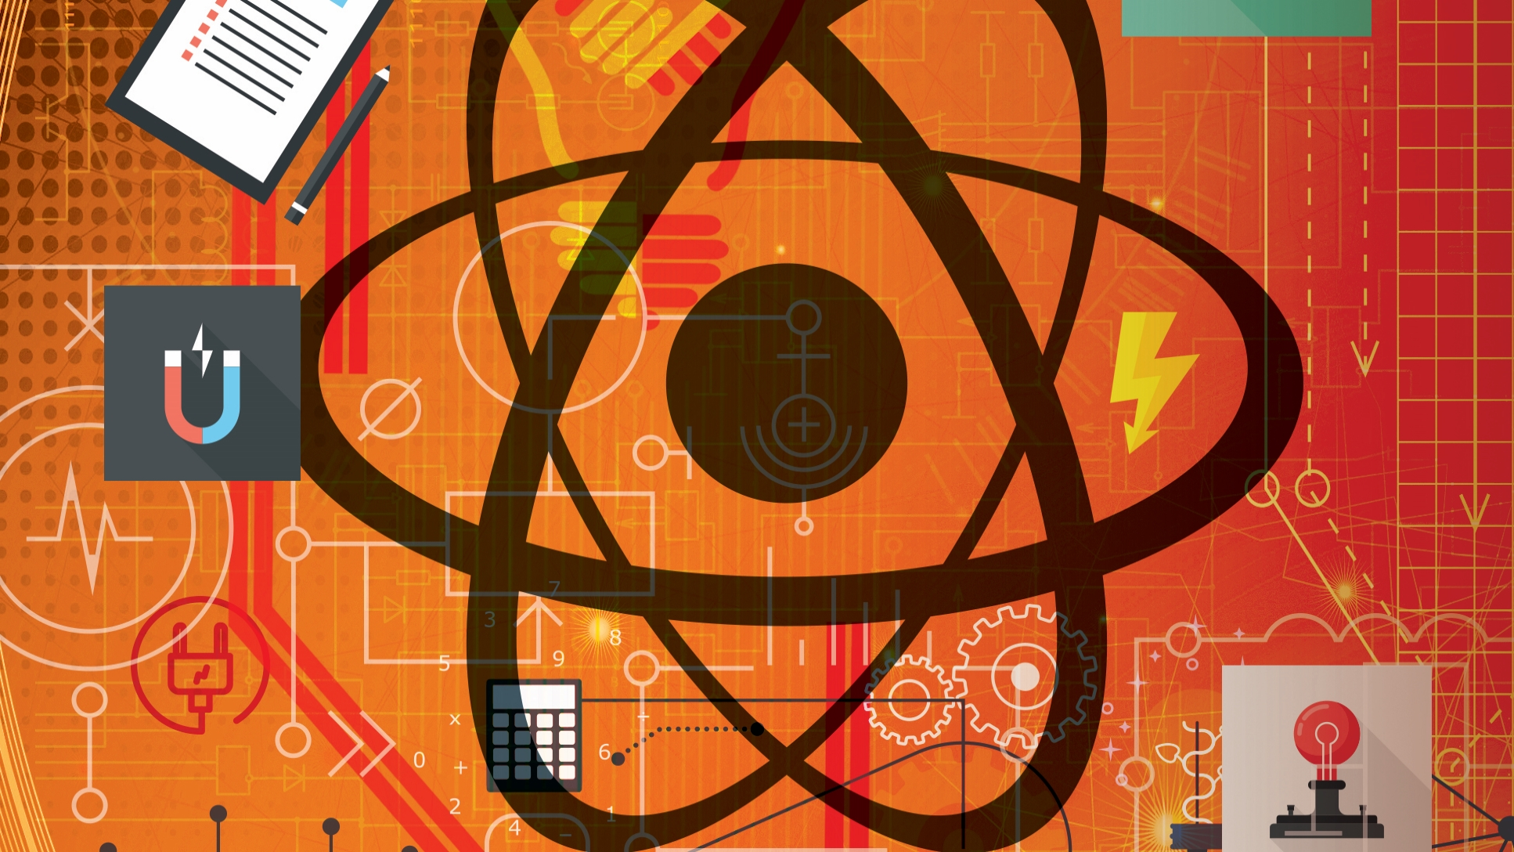
Engineering Science
N1

Slide 2
Chapter 1: Dynamics
SCALARS AND VECTORS
A scalar is a quantity which has only magnitude while a vector is a quantity which has both magnitude and direction.
www.futuremanagers.com

Slide 3
Chapter 1: Dynamics (continued)
GRAPHICAL REPRESENTATION OF SCALARS AND VECTORS
A scalar may be represented graphically by drawing a straight line to a suitable scale. By representing its direction in the form of an arrow head, the scalar quantity becomes a vector quantity.
www.futuremanagers.com

Slide 4
Chapter 1: Dynamics (continued)
VECTOR ADDITION
The addition of vectors working along a straight line, is similar to numerical and scalar addition.
Coplanar vectors, also known as two-dimensional vectors, act in the same plane.
www.futuremanagers.com

Slide 5
Chapter 1: Dynamics (continued)
BOW’S NOTATION
Bow’s notation can be used to classify the vectors in vector diagrams. The plane in which the vectors act, may be regarded as divided into spaces by the lines of action of the forces.
www.futuremanagers.com

Slide 6
Chapter 1: Dynamics (continued)
MASS AND WEIGHT
Mass (measured in kilograms) is the amount of matter a body contains while weight (measured in newtons) is the gravitational force acting on a body.
www.futuremanagers.com

Slide 7
Chapter 1: Dynamics (continued)
DISTANCE AND DISPLACEMENT
Distance is the distance covered, regardless of direction and displacement is the straight line distance that a body moves.
www.futuremanagers.com

Slide 8
Chapter 1: Dynamics (continued)
SPEED AND VELOCITY
Speed is the rate of change of distance and velocity is speed in a given direction or the rate of change of displacement.
www.futuremanagers.com

Slide 9
Chapter 1: Dynamics (continued)
ACCELERATION
Acceleration is the rate of change of velocity.
www.futuremanagers.com

Slide 10
Chapter 1: Dynamics (continued)
FREE-FALLING BODIES
All free-falling bodies have the same acceleration. This is any object which has only the gravitational pull working on it.
www.futuremanagers.com

Slide 11
Chapter 2: Statics
FORCES
Force is that influence which, when applied to a body, will change or tend to change its state of rest or uniform motion in a straight line. It is measured in newtons.
www.futuremanagers.com

Slide 12
Chapter 2: Statics (continued)
PARALLELOGRAM OF FORCES
If two similar forces acting on a point are represented as vectors by two adjacent sides of a parallelogram, their resultant will be represented in magnitude and direction by the diagonal of the parallelogram drawn from that point.
www.futuremanagers.com

Slide 13
Chapter 2: Statics (continued)
TRIANGLE OF FORCES
If three forces acting at a point are in equilibrium, they can be represented in
magnitude and direction by the sides of a triangle taken in order.
www.futuremanagers.com

Slide 14
Chapter 2: Statics (continued)
LIFTING MACHINES
Lifting machines are mechanical devices designed to make work easier. These machines make it possible for a load (output force) larger that the applied effort (input force) to be raised.
www.futuremanagers.com

Slide 15
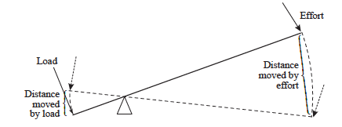
Chapter 2: Statics (continued)
THE LEVER
The lever is probably the simplest of all lifting machines.
www.futuremanagers.com

Slide 16
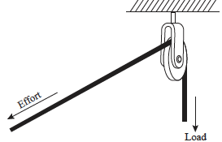
Chapter 2: Statics (continued)
PULLEY BLOCK SYSTEMS
This simple machine does not have a mechanical advantage, since the velocity ratio of the effort to the load is one. It does, however, have the great advantage of changing the line of action of the effort.
www.futuremanagers.com

Slide 17
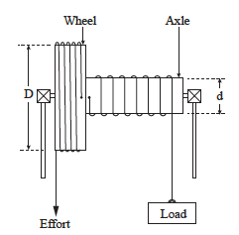
Chapter 2: Statics (continued)
WHEEL AND AXLE
The wheel and axle is an adaption of the crank and drum, which has been one of the most common and simple machines of the past. This winch is easy to construct and was popular for raising water from wells. It still has many uses today.
www.futuremanagers.com

Slide 18
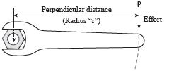
Chapter 2: Statics (continued)
MOMENTS
The moment of a force is the turning effect of a force about a point. A spanner tightening a nut is an example of this.
www.futuremanagers.com

Slide 19
Chapter 2: Statics (continued)
LEVERS (1 FORCE)
A lever is a rigid bar or other similar structure. When it is used to produce a turning moment at a point, the turning moment is usually referred to as a torque.
www.futuremanagers.com

Slide 20
Chapter 2: Statics (continued)
LEVERS (2 FORCES)
In a two force lever, the weight of the load is great compared to the applied effort but the distance between the set in the fulcrum and load, is small compared to the distance from the fulcrum to the effort.
www.futuremanagers.com

Slide 21
Chapter 2: Statics (continued)
BEAMS
When a horizontal beam, resting on supports, is in equilibrium when acted upon by vertical forces, then;
Sum of clockwise moments = sum of anticlockwise moments about the same point, and;
Sum of upward forces = sum of downward forces.
www.futuremanagers.com

Slide 22
Chapter 3: Energy, work and power
ENERGY
Energy is the capacity to do work. Energy is measured in joules.
Energy occurs in many forms such as thermal (or heat), chemical, electrical, potential, kinetic, magnetic and atomic energy.
www.futuremanagers.com

Slide 23
Chapter 3: Energy, work and power (continued)
POTENTIAL ENERGY (PE)
Potential energy is the energy a body possesses by virtue of its “position” or “state of strain”.
www.futuremanagers.com

Slide 24
Chapter 3: Energy, work and power (continued)
KINETIC ENERGY (KE)
Kinetic energy is the energy that a body possesses by virtue of its motion.
www.futuremanagers.com

Slide 25
Chapter 3: Energy, work and power (continued)
HEAT ENERGY
Heat is associated with the kinetic energy of molecules. Heat can be used to
convert water into steam. The heat energy stored in the steam can then be used to drive steam engines or steam turbines.
www.futuremanagers.com

Slide 26
Chapter 3: Energy, work and power (continued)
CHEMICAL ENERGY
When fuels such as wood, coal and gas burn, chemical reactions take place and heat energy is released. In a petrol engine, the chemical energy in the petrol is converted into heat and mechanical energy.
www.futuremanagers.com

Slide 27
Chapter 3: Energy, work and power (continued)
ELECTRICAL ENERGY
Electrical energy is probably the most useful form of energy and is associated with the forces between electrical charges. It is readily obtainable, economical, efficient and easy to control.
www.futuremanagers.com

Slide 28
Chapter 3: Energy, work and power (continued)
CONSERVATION OF ENERGY
The law of the conservation of energy states that energy cannot be created or destroyed, but it can be changed from one form to another.
www.futuremanagers.com

Slide 29
Chapter 3: Energy, work and power (continued)
ENERGY CONVERSION
Energy can be converted from one form to another. For example, potential energy can be converted into kinetic energy when movement is gained.
www.futuremanagers.com

Slide 30
Chapter 3: Energy, work and power (continued)
WORK
Work is the measure of change of energy state. It is measured in joules.
Work is done regardless of whether the force moves in a straight line or rotates about a point.
$$W=Fxs$$
Where W = work,
F = Effective force, and
s = distance.
www.futuremanagers.com

Slide 31
Chapter 3: Energy, work and power (continued)
POWER
Power is the rate of doing work.
$$P=\frac{W}{t}$$
Where P = power,
W = work, and
t = time.
www.futuremanagers.com

Slide 32
Chapter 4: Heat
HEAT AND TEMPERATURE
Heat is a form of energy and temperature is an indication of the degree of hotness or coldness of a body.
www.futuremanagers.com

Slide 33
Chapter 4: Heat (continued)
TEMPERATURE MEASUREMENT
There are various instruments used for measuring temperatures. Instruments used for measuring relatively low temperatures are referred to as thermometers and those used for measuring high temperatures are known as pyrometers.
www.futuremanagers.com

Slide 34
Chapter 4: Heat (continued)
THERMOMETERS
Coloured alcohol thermometers; and
Mercury thermometers.
An increase in temperature will cause the liquid to expand and move further up the bore. This can then easily be read against the scale.
www.futuremanagers.com

Slide 35
Chapter 4: Heat (continued)
HEAT TRANSFERS
Heat can be transferred in three ways:
Conduction;
Convection; and
Radiation.
www.futuremanagers.com

Slide 36
Chapter 4: Heat (continued)
EFFECTS OF HEAT
When heat is added to or removed from a substance, changes take place. Some of the common effects are:
Temperature changes;
Colour changes;
Volume changes;
Change of phase; and
Change of resistance.
www.futuremanagers.com

Slide 37
Chapter 4: Heat (continued)
THERMOCOUPLE
A typical thermocouple can be used:
For measuring temperatures in furnaces;
To be permanently inserted (wound) inside the windings of large electric motors; and
To be permanently placed in hard to reach places of machines.
www.futuremanagers.com

Slide 38
Chapter 4: Heat (continued)
SPECIFIC HEAT CAPACITY
Specific heat capacity is the amount of heat energy required to raise the temperature of 1 kg of a substance 1 °C (or 1 K).
www.futuremanagers.com

Slide 39
Chapter 4: Heat (continued)
HEAT TRANSFER (SUBSTANCES IN CONTACT)
When a hot substance is mixed or brought into contact with a cooler one, heat is transferred from the hotter substance to the cooler one until their temperatures are equal.
www.futuremanagers.com

Slide 40
Chapter 4: Heat (continued)
THERMAL EXPANSION
The volume of most substances increases when their temperature is increased. In engineering, the increase in volume of a liquid or gas is of most importance. In the case of solids, the increase in area and length is of most importance. When a substance is cooled, the reverse takes place.
www.futuremanagers.com

Slide 41
Chapter 5: Composition of matter
MATTER
Familiar examples of matter are water, air, copper, tin, smoke, iron and salt. All matter is made up of extremely small particles called molecules.
www.futuremanagers.com

Slide 42
Chapter 5: Composition of matter (continued)
COMPOUND SUBSTANCES
Hundreds of thousands of different compound substances are made by combining two or more different elements. Water, for example, is made from two parts hydrogen and one part oxygen.
www.futuremanagers.com

Slide 43
Chapter 5: Composition of matter (continued)
ELEMENTS
An element is a substance that contains only one kind of atom.
Examples of these are the familiar elements aluminium, carbon, chlorine, copper, gold, hydrogen, iron, lead, mercury, oxygen, silver, sodium and tin.
www.futuremanagers.com

Slide 44
Chapter 5: Composition of matter (continued)
ATOMS
An atom is the smallest part of an element that has all the characteristics of that element. Atoms are made up of electrons, neutrons and protons.
www.futuremanagers.com

Slide 45
Chapter 5: Composition of matter (continued)
IONS
When an atom gains or loses one or more electrons, it is said to be ionised. The atom then has a net negative or net positive charge and is referred to as an ion.
www.futuremanagers.com

Slide 46
Chapter 5: Composition of matter (continued)
PHASES OF MATTER
Matter exists in three phases (states):
Solid;
Liquid; and
Gaseous (gas or vapour).
www.futuremanagers.com

Slide 47
Chapter 6: Electricity
CONDUCTORS AND CURRENT FLOW
A conductor is a substance through which an electrical current can flow easily. Electric current is the movement of electric charges in a specific direction through a material.
www.futuremanagers.com

Slide 48
Chapter 6: Electricity (continued)
CONDUCTOR MATERIALS
Some materials are better conductors than others. When referring to conducting materials, metals are generally thought of first, but non metals such as carbon and various gases and liquids, can also act as conductors.
www.futuremanagers.com

Slide 49
Chapter 6: Electricity (continued)
INSULATORS
An insulator is any substance which prevents the flow of electric current. Examples of insulating materials are:
PVC;
Glazed porcelain; and
Mica.
www.futuremanagers.com

Slide 50
Chapter 6: Electricity (continued)
RESISTANCE
Resistance is the opposition offered to the flow of electrical current.
A device or wire designed specifically to oppose the flow of current in a circuit is known as a resistor.
www.futuremanagers.com

Slide 51
Chapter 6: Electricity (continued)
THE ELECTRIC CIRCUIT
For a simple, practical circuit, the following is required:
An electrical power device, e.g. a cell or a battery;
An electric appliance or device (load), e.g. an electric lamp, bell or radio, which can be operated from the power device; and
Two lengths of insulated conductor connecting the device to the power supply in order to allow current (electrons) to flow.
www.futuremanagers.com

Slide 52
Chapter 6: Electricity (continued)
OHM’S LAW
According to Ohm’s law, the current flowing in a circuit is proportional to the applied voltage and inversely proportional to the resistance of the circuit.
$$I=\frac{V}{R}$$
Where I = current;
V = Potential difference; and
R = Resistance.
www.futuremanagers.com

Slide 53
Chapter 6: Electricity (continued)
HEATING EFFECT OF AN ELECTRIC CURRENT
When the flow of electric current is restricted, heat energy is generated. Since there is no perfect conductor, heat energy will be generated in all parts of a circuit where current is flowing.
www.futuremanagers.com

Slide 54
Chapter 6: Electricity (continued)
POWER IN AN ELECTRICAL CIRCUIT
When work is done, energy is expended. Consider a circuit in which a certain potential difference is applied across a resistor: This will result in a current flow. In order to get the current to flow, work must be done to keep the electrons moving.
www.futuremanagers.com

Slide 55
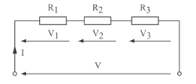
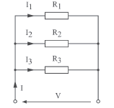
Chapter 6: Electricity (continued)
GROUPING OF RESISTORS
Resistors in series:
Resistors in parallel:
www.futuremanagers.com

Slide 56
Chapter 6: Electricity (continued)
FACTORS INFLUENCING THE RESISTANCE OF A CONDUCTOR
The resistance of a conductor depends on four factors, namely:
The type of material from which the conductor is made.
The length of the conductor in metres (m).
The cross-sectional area of the conductor in $m^{2}$.
The temperature of the conductor.
www.futuremanagers.com

Slide 57
Chapter 6: Electricity (continued)
TEMPERATURE COEFFICIENT OF RESISTANCE ($α$)
The resistance of most materials are affected by changes in temperature.
Temperature coefficient of resistance is the increase in unit resistance of a substance, per unit rise in temperature from 0$°$C.
www.futuremanagers.com

Slide 58
Chapter 6: Electricity (continued)
ELECTROMAGNETISM
The magnetic field or entire quantity of magnetic lines surrounding a magnet, taken as a whole, is called magnetic flux or magnetic field.
One of the phenomena of an electric current is its ability to produce a magnetic field around a current-carrying conductor.
www.futuremanagers.com

