Slide 1


Industrial Electronics
N6

Slide 2
Module 1: Transients
TRANSIENT THEORY
Whenever an electronic circuit undergoes a disturbance either by a change in the applied voltage or a change in one of the circuit elements, there is a transitional period during which the branch currents and voltages change from their former values to new values. After this transitional interval, known as the transient, the circuit is said to be in a steady state (final value conditions).
www.futuremanagers.com

Slide 3
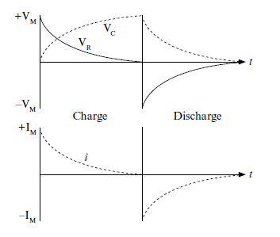
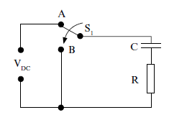
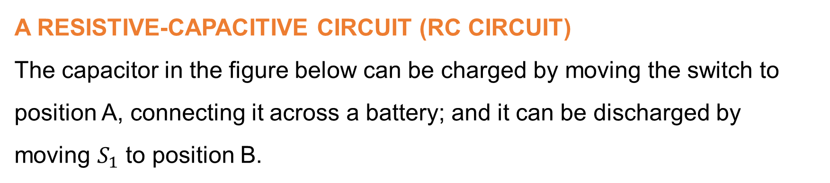
Module 1: Transients (continued)
A RESISTIVE-CAPACITIVE CIRCUIT (RC CIRCUIT)
The capacitor in the figure below can be charged by moving the switch to position A, connecting it across a battery; and it can be discharged by moving $S_{1}$ to position B.
www.futuremanagers.com

Slide 4

Module 1: Transients (continued)
TIME CONSTRAINT OF AN RC CIRCUIT
The time constant of an energy-storing circuit may be defined as the time taken for the circuit to reach steady-state conditions after a disturbance, assuming a constant rate of change in the charging or discharging current, where $τ=$R.C sec. In the practical situation the time constant of such a circuit is found to be the time taken for the voltages and currents to change by 63,2% of the total change.
www.futuremanagers.com

Slide 5
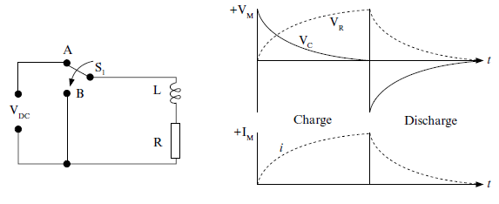
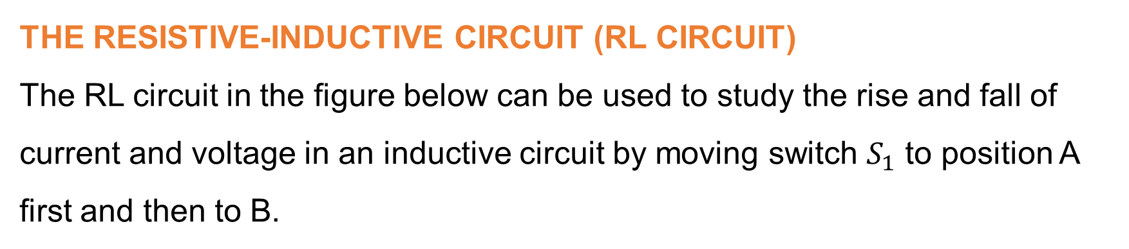
Module 1: Transients (continued)
THE RESISTIVE-INDUCTIVE CIRCUIT (RL CIRCUIT)
The RL circuit in the figure below can be used to study the rise and fall of current and voltage in an inductive circuit by moving switch $S_{1}$ to position A first and then to B.
www.futuremanagers.com

Slide 6

Module 1: Transients (continued)
TIME CONSTRAINT OF AN RL CIRCUIT
The time constant of an RL circuit is the time taken for the circuit to reach steady-state conditions after a disturbance, assuming a constant rate of change in charging or discharging current. This is the time taken for voltages and currents to change by 63,2% of the total change and is expressed by
$τ=\frac{L}{R}$ seconds.
www.futuremanagers.com

Slide 7
Module 1: Transients (continued)
THE RINGING CIRCUIT (RLC CIRCUIT)
Circuits containing resistance, inductance and capacitance (RLC circuits are the most important of all circuits when considering transient phenomena (temporary observations) since they can produce resonance when supplied with an AC source.
www.futuremanagers.com

Slide 8
Module 1: Transients (continued)
RESOLUTION
If there are no losses in the flow of energy in an capacitor and inductor, then a point will be reached at which this build-up and collapse of the magnetic field around the inductor will take place at a fixed rate known as the resonant frequency.
www.futuremanagers.com

Slide 9

Module 1: Transients (continued)
CURRENT DELAY IN AN RLC CIRCUIT
The amplitude of each successive oscillation decreases exponentially as governed by the general expression $e^{−ζ.t}$. As time (t) increases the amplitude decreases and the rate of oscillation decay is determined by the damping factor, $ζ$. The decrement is given by the ratios of successive peaks:
$$\frac{A}{B}=\frac{C}{D}=…$$
www.futuremanagers.com

Slide 10

Module 1: Transients (continued)
NUMBER OF OSCILLATIONS IN A WAVE TRAIN
The number of oscillations in a wave train is expressed by ‘n’ being;
$$n=1+\frac{Ln100}{∫}=1+\frac{4.605}{∫}$$
www.futuremanagers.com

Slide 11
Module 2: Transducers
TRANSDUCER THEORY
A transducer is a device which is actuated (start a movement or process) by power from one system and supplies power in another form to a second system. The output power is proportional to the actuating power which means that the output power may be used as a measured variable to indicate actual conditions existing in a process or to supply a correction signal in conjunction with a reference representing ideal conditions.
www.futuremanagers.com

Slide 12
Module 2: Transducers (continued)
SELECTING A TRANSDUCER
A number of elementary questions should be asked before a transducer is selected, for example:
What is the physical quantity to be measured?
Which transducer principle can be best used to measure this quantity?
What accuracy is required for this measurement?
www.futuremanagers.com

Slide 13
Module 2: Transducers (continued)
DATA ACQUISITION SYSTEMS
Data acquisition systems are used to measure signals obtained in two ways:
Signals originating from direct measurement of electrical quantities; these may include DC and AC voltages, frequency or resistance and are typically found in areas such as electronic component testing, environmental studies and quality analysis work.
Signals originating form transducers, such as strain gauges and thermocouples.
www.futuremanagers.com

Slide 14
Module 2: Transducers (continued)
ANALOGUE DATA ACQUISITION SYSTEMS
An analogue data acquisition system typically consists of some or all of the following elements:
Transducers;
Signal conditioners;
Visual display units;
Graphical recording instruments; and
Computer systems.
www.futuremanagers.com

Slide 15
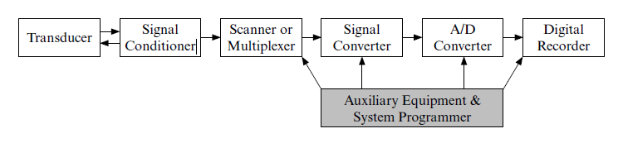
Module 2: Transducers (continued)
DIGITAL DATA ACQUISITION SYSTEMS
The essential functional operations within a digital system include handling analogue signals, making the measurement, converting and handling digital data and internal programming and control.
www.futuremanagers.com

Slide 16
Module 2: Transducers (continued)
AMPLIFICATION
The output signal from a transducer is generally a low voltage level and requires amplification to the desired measuring range. An operational amplifier multiplier circuit providing the necessary amplification is generally used for the purpose of amplification.
www.futuremanagers.com

Slide 17
Module 2: Transducers (continued)
ATTENUATION
In cases where the output signal voltage ranges from two selected transducers (or one transducer and a reference signal) are too great to be applied to the input terminals of an op-amp for further conditioning and modification, they would have to be attenuated first before being mixed and applied to the op-amp input stage.
www.futuremanagers.com

Slide 18
Module 2: Transducers (continued)
LINEARISATION (ARRANGED IN A LINE)
A linear system is one in which cause (input) and effect (output) are directly proportional. Non-linearity is a measure of the departure from proportionality. All devices are characterised by some degree of non-linearity. In order to obtain an overall linear response, the output of the transducer is provided with an inverse nonlinear correction.
www.futuremanagers.com

Slide 19
Module 2: Transducers (continued)
OFFSETTING
Offsetting makes use of analogue techniques to shift the reference level of a signal by a predictable amount.
www.futuremanagers.com

Slide 20
Module 2: Transducers (continued)
SIGNAL CONDITIONING
Once a particular form of transducer has been chosen for a particular application, provision must be made for appropriate excitation and conditioning of the output signal. The nature of the conditioning depends on the characteristics of the transducer and the signal destination.
www.futuremanagers.com

Slide 21
Module 2: Transducers (continued)
INFERFACING
Connecting different types of circuits, different analogue or digital units and inputs or loads to other electronic units all require some sort of interfacing. Interface circuits may be categorised as either driver or receiver units. Interfacing also occurs when connecting signals between various terminals of a digital system. Signals from such devices as a teletype, video terminal, card reader or line printer are usually one of a number of signal forms.
www.futuremanagers.com

Slide 22
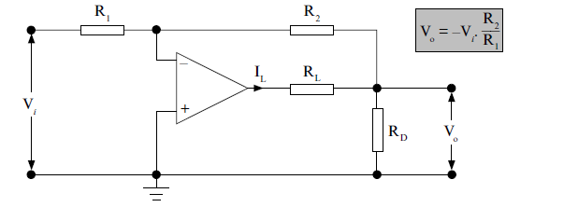
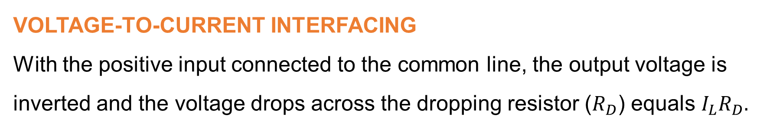
Module 2: Transducers (continued)
VOLTAGE-TO-CURRENT INTERFACING
With the positive input connected to the common line, the output voltage is inverted and the voltage drops across the dropping resistor ($R_{D}$) equals $I_{L}R_{D}.$
www.futuremanagers.com

Slide 23
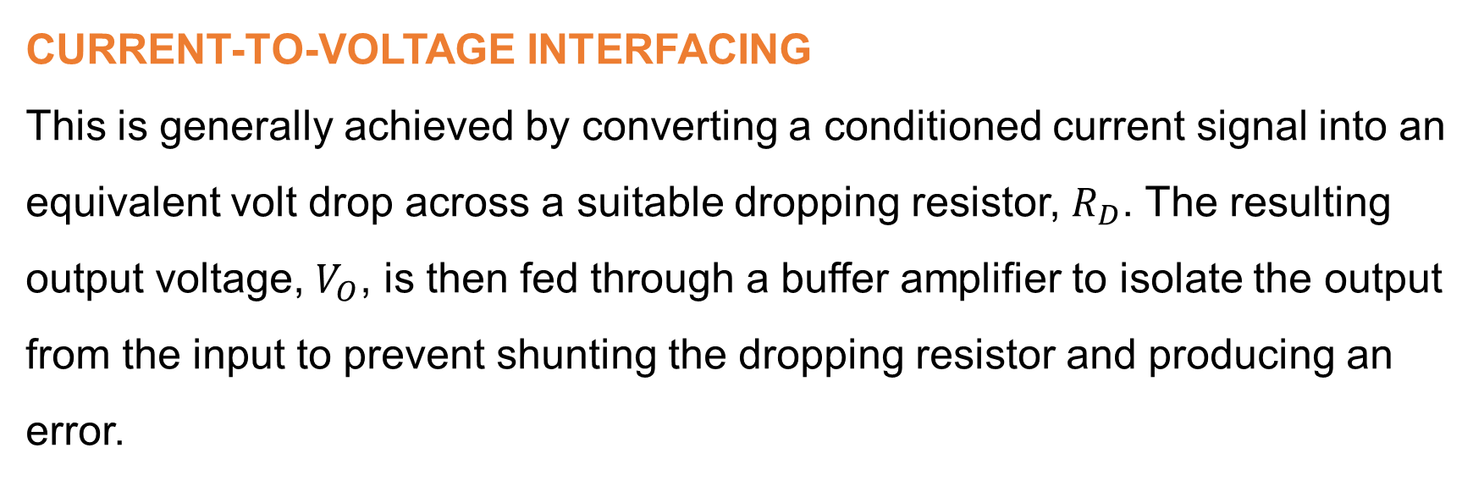
Module 2: Transducers (continued)
CURRENT-TO-VOLTAGE INTERFACING
This is generally achieved by converting a conditioned current signal into an equivalent volt drop across a suitable dropping resistor, $R_{D}$. The resulting output voltage, $V_{O}$, is then fed through a buffer amplifier to isolate the output from the input to prevent shunting the dropping resistor and producing an error.
www.futuremanagers.com

Slide 24
Module 2: Transducers (continued)
ANALOGUE COMBINATION CIRCUITS
The operational amplifier (op-amp) is a very high-gain differential amplifier employing voltage feedback to provide a stabilised voltage gain. The ideal op-amp would possess the following properties:
Infinite input impedance;
Infinite bandwidth;
Zero output impedance;
Zero open-loop voltage; and
Zero offset voltage.
www.futuremanagers.com

Slide 25
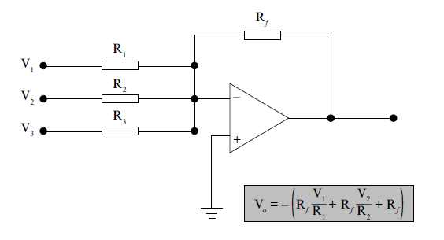
Module 2: Transducers (continued)
SUMMING AMPLIFIER
The most useful amplifier circuit in analogue computers employed to add (sum) a number of input voltages algebraically, each multiplied by a constant-gain factor.
www.futuremanagers.com

Slide 26
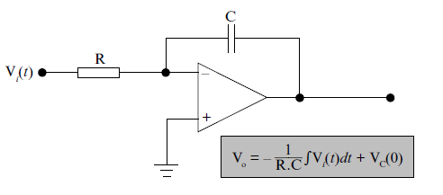
Module 2: Transducers (continued)
INTEGRATOR CIRCUIT
The feedback component employed in this amplifier arrangement is a capacitor. The ability to integrate a given signal provides the analogue computer with the tools required to solve differential equations and allows for the setup of a variety of electronic circuits using physical-system operations.
www.futuremanagers.com

Slide 27
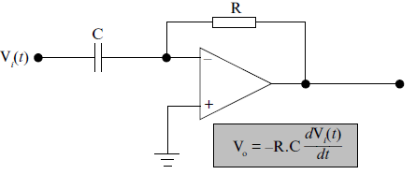
Module 2: Transducers (continued)
DIFFERENTIATOR CIRCUIT
www.futuremanagers.com

Slide 28
Module 2: Transducers (continued)
ANALOGUE COMPARATOR
The analogue comparator circuit utilises both the inverting- and non-inverting inputs of an op-amp for different incoming analogue signals. The comparator then generates a digital output signal that indicates the relative states between the two different input analogue signals.
www.futuremanagers.com

Slide 29
Module 3: Ultrasonics
ULTRASONIC THEORY
The term ultrasonic refers to acoustic (sound) energy at frequencies above the audible range of sound which has a limit of about 20 kHz.
www.futuremanagers.com

Slide 30
Module 3: Ultrasonics (continued)
PIEZO-ELECTRICITY
The piezo-electric effect refers only to non-conductive materials. The word ‘piezo’ implies to press or ‘be pressed’. This effect is divided into two main groups:
The direct piezo electric effect; and
The converse piezo electric effect.
www.futuremanagers.com

Slide 31
Module 3: Ultrasonics (continued)
MAGNETOSTRICTION
The term magnetostriction refers only to conductive materials such as iron-cobalt and nickel alloys. These materials pose a rather unique property in that the material itself will undergo dimensional changes (similar to the piezo-electric crystal) when subjected to oscillating magnetic or electric fields.
www.futuremanagers.com

Slide 32
Module 3: Ultrasonics (continued)
ULTRASONIC CLEANING
This method is particularly suited for removing dirt from delicate mechanisms such as jewellery, hair-springs, delicate components/parts etc, where physical contact with a brush or exposure from a high pressure air jet could cause damage. The cleaning apparatus consists of a tub partially filled with a cleaning fluid having the ultrasonic transducers attached to the sides or bottom of the tub, usually on the outside.
www.futuremanagers.com

Slide 33
Module 3: Ultrasonics (continued)
ULTRASONIC MACHINING
Certain materials are too hard or too brittle to be machined satisfactorily by conventional methods but can be shaped by abrasion (place or spot that has been worn). An ultrasonic drill makes use of this technique to sink cavities of various shapes into such materials.
www.futuremanagers.com

Slide 34
Module 3: Ultrasonics (continued)
ULTRASONIC SOLDERING
A major problem encountered with soldering aluminium and its alloys is that an oxide film forms over any cleaned surface immediately after the soldering action, prior to the solder having set to the material (aluminium). This newly formed oxide film prevents the solder from adhering to the aluminium surface.
www.futuremanagers.com

Slide 35
Module 3: Ultrasonics (continued)
ULTRASONIC WELDING
Should two pieces of metal with ‘perfectly’ smooth and flat surfaces be brought into close physical contact, the surface atoms of each could unite with one another to form a permanent bond. In the ultrasonic welding process the oxide films are broken down by using the vibratory energy of the ultrasonic transducer to disperse the oxide film and also to cause minor deformation of the surface irregularities of both surfaces to form a solid bond.
www.futuremanagers.com

Slide 36
Module 4: X-rays and radio activity
ELECTROMAGNETIC RADIATION
Electromagnetic radiation is described as energy waves produced by the oscillation (or acceleration) of an electric charge.
www.futuremanagers.com

Slide 37
Module 4: X-rays and radio activity (continued)
PROPERTIES OF ELECTROMAGNETIC RADIATION
There are three ways in which energy can be transmitted:
Electromagnetic radiation;
Conduction; and
Convection (transfer of heat).
www.futuremanagers.com

Slide 38
Module 4: X-rays and radio activity (continued)
X-RAYS
X-rays were discovered, accidentally, in 1895 while studying cathode rays by the German physicist Wilhelm C. Roentgen who called this invisible radiation “X-rays” because of its unknown nature.
www.futuremanagers.com

Slide 39
Module 4: X-rays and radio activity (continued)
CHARACTERISTICS OF X-RAYS
X-rays consist of radiation of very short wavelengths and therefore have a very high frequency. X-rays consist of high energy photons which are also very penetrating due to the short wavelength of the radiation.
www.futuremanagers.com

Slide 40
Module 4: X-rays and radio activity (continued)
PRODUCTION OF X-RAYS
X-rays are produced (generated) whenever a beam of high-velocity electrons strikes a material object. Most of the energy of the electrons is lost in heat. The remainder of the energy produces X-rays by causing changes in the target’s atoms as a result of the impact. The X-rays emitted can have no more energy than the kinetic energy of the electrons that produce them.
www.futuremanagers.com

Slide 41
Module 4: X-rays and radio activity (continued)
CONSTRUCTION OF X-RAY TUBES
A modern X-ray tube has a helical tungsten filamentary cathode and a copper anode containing an insert called the target. The target is generally made of materials such as tungsten or molybdenum. The anode itself is made of copper because of its ability to function as a heat exchanger to remove the great amount of heat which is generated along with the X-rays.
www.futuremanagers.com

Slide 42
Module 4: X-rays and radio activity (continued)
OPERATING PRINCIPLE
With the anode at a high positive potential with respect to the cathode, the electrons emitted from the hot filament are accelerated in a narrow beam and travel towards the tungsten target at high speed. When these electrons collide with the atoms of the target, they dislodge electrons from their normal energy levels in the target material. These excited electrons gain energy and move into higher energy levels, producing mainly heat.
www.futuremanagers.com

Slide 43
Module 4: X-rays and radio activity (continued)
POWER SUPPLIES FOR X-RAYS TUBES
Essentially, the power supply for any X-ray generator consists of a low-voltage alternating current filament transformer and for the high voltage side:
Either an alternating current transformer, or
An alternating current transformer followed by a suitable high-voltage rectifier system.
www.futuremanagers.com

Slide 44
Module 4: X-rays and radio activity (continued)
DETERMINING THE EFFICIENCY OF X-RAYS TUBES
The factors which determine the efficiency of an X-ray are:
The atomic number of the material.
The number of electrons penetrating the target.
The applied (accelerating) voltage.
www.futuremanagers.com

Slide 45
Module 4: X-rays and radio activity (continued)
RADIO ACTIVITY
Radiation (or particle) detectors are instruments used to detect and study fundamental nuclear particles. These detectors are categorised as being either:
Gas-filled detectors;
Photomultiplier tubes; and
Semiconductor detectors.
www.futuremanagers.com

Slide 46
Module 4: X-rays and radio activity (continued)
PROPORTIONAL COUNTER
The physical construction of the proportional counter is similar to that of the ionisation chamber and Geiger-Müller counter in that the counter consists of an enclosed tube filled with an inert gas. Electrodes, either rods or circular plates, are inserted into the gas-filled tube to which a relatively high DC voltage (280 V – 950 V) is applied.
www.futuremanagers.com

Slide 47
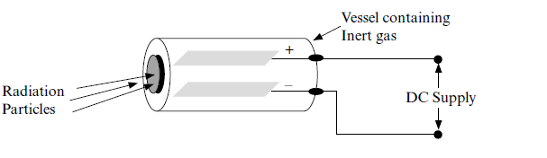
Module 4: X-rays and radio activity (continued)
IONISATION CHAMBER
One of the first detectors to be used in nuclear physics was the ionisation chamber, which consists essentially of a closed vessel containing a gas and equipped with two electrodes at different electrical potentials.
www.futuremanagers.com

Slide 48
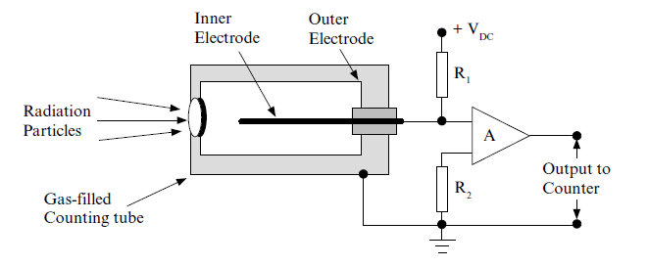
Module 4: X-rays and radio activity (continued)
GEIGER-MÜLLER COUNTER
Ionisation chambers adapted to detect individual ionising particles or radiation are called counters.
www.futuremanagers.com

Slide 49

Module 4: X-rays and radio activity (continued)
PHOTOMULTIPLIER TUBE
Used to detect very low light or radiation levels. Special amplification of the photocurrent is necessary in most applications. The multiplier tube uses secondary emission to provide current amplification in excess of a factor ${10}^{6}$ which then becomes a very useful detector for low light or radiation levels. In a photomultiplier the electrons emitted by the photo-cathode are electrostatically directed toward a secondary emitting surface, called a dynode.
www.futuremanagers.com

Slide 50
Module 4: X-rays and radio activity (continued)
SEMICONDUCTOR DETECTOR
The semiconductor detector consists of a reverse biased PN junction. When radiant energy is allowed to penetrate the depletion region, electrons-hole pairs are generated and momentarily increase the conduction across the junction. This behaviour of the semiconductor material is similar to that of the gas-filled ionisation chamber in that the semiconductor detector also produces a pulsed output which is amplified and counted.
www.futuremanagers.com

Slide 51
Module 5: Automatic inspection, testing and NDT
AUTOMATIC INSPECTION, TESTING AND GRADING
An automatic inspection system generally takes the form of an inspection, testing, sorting and grading device which inspects production items for conformity to specifications by means of electronic circuitry and pre-programmed parameters.
www.futuremanagers.com

Slide 52
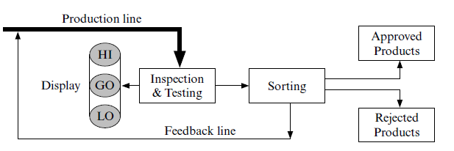
Module 5: Automatic inspection, testing and NDT (continued)
TWO-WAY AND THREE-WAY SYSTEMS
The 2-way system simply accepts or rejects items, whereas the 3-way system sorts the rejected items into those which can be returned to the production line for reworking and those which have to be scrapped.
www.futuremanagers.com

Slide 53

Module 5: Automatic inspection, testing and NDT (continued)
RESISTIVE AND CAPACITIVE TESTING DEVICES
The transformer ratio arm bridge utilises a current balance technique. One winding on a transformer core receives alternating current ($I_{1}$) produced by a known voltage and unknown impedance. A second core winding is driven by a balancing current ($I_{f}$) produced by a known variable voltage and known standards of resistance and capacitance. A further core winding acts as a search coil to allow determination of a null in the core flux.
www.futuremanagers.com

Slide 54
Module 5: Automatic inspection, testing and NDT (continued)
METAL DETECTORS
A metal detector operates on the principle of employing a search coil in an oscillator circuit. When metallic objects are in the sensing range of the coil there is an inductive change in the oscillator circuit and consequently the frequency changes.
www.futuremanagers.com

Slide 55
Module 5: Automatic inspection, testing and NDT (continued)
NON-DESTRUCTIVE TESTING (NDT OR NDI)
One of the earliest and still very popular methods of non-destructive testing of castings involves placing the casting in the field of an electro-magnet and then painting the surface of the casting with a mixture of oil and iron filings.
www.futuremanagers.com

Slide 56
Module 5: Automatic inspection, testing and NDT (continued)
THE USE OF X-RAY TUBES FOR NON-DESTRUCTIVE TESTING
The operator views the image on a fluorescent screen in a darkened room. Flaws and cracks in castings (for example), show up as dark lines or shadows on the image of the casting seen on the fluorescent screen.
www.futuremanagers.com

Slide 57
Module 5: Automatic inspection, testing and NDT (continued)
THE USE OF ULTRASONICS FOR NDT
Minute cracks, checks and voids, too small to be seen by X-rays, are located using ultrasonic techniques. An ultrasonic test instrument requires access to only one surface of the material to be inspected and can be used with either straight line or angle beam testing techniques.
www.futuremanagers.com

Slide 58
Module 6: Electronic safety devices
INDUSTRIAL SAFETY DEVICES
Electronic safety devices can be made sophisticated and independent of manual effort, making it difficult for personnel operating the machine to by-pass the safety device. The purpose of fitting electronic safety devices in industry is two-fold:
To prevent injury or death of workers;
To prevent damage to machinery.
www.futuremanagers.com

Slide 59
Module 6: Electronic safety devices (continued)
PHOTO-ELECTRIC SAFETY DEVICES
The term electro-optical or opto-electronics designates a domain comprising electronic circuits having at least one feedback by optical means, such as light rays. A photoelectric transducer is therefore required for converting information bearing light variations into electric signals. Different types of devices include industrial punch presses, smoke detectors, and flame failure protection devices.
www.futuremanagers.com

Slide 60
Module 6: Electronic safety devices (continued)
INTRINSIC SAFETY
Intrinsic safety describes the explosion protection technique which prevents faults in low power measurement and control systems from igniting flammable atmospheres in hazardous areas. Intrinsically safe systems are designed to prevent high energy sources (electrical, chemical or a combination thereof) from placing ignition-capable currents or voltages on wires leading into hazardous areas.
www.futuremanagers.com

Slide 61
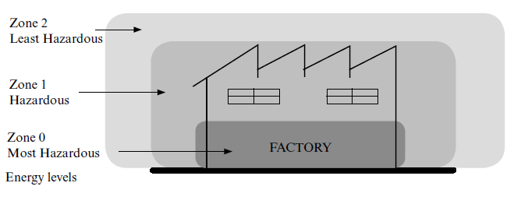
Module 6: Electronic safety devices (continued)
ENERGY LEVELS
Safe energy levels cannot be defined in any simple form. Ignition depends on the specific gas, gas concentration, voltage, current, energy storage elements, contact material, contact size and the speed of opening or closing of contacts.
www.futuremanagers.com

Slide 62
Module 6: Electronic safety devices (continued)
DETERMINING INTRINSIC SAFETY
Different steps are involved in determining intrinsic safety:
Circuit analysis;
Evaluation;
Construction review;
Transformer construction; and
Isolation by encapsulation.
www.futuremanagers.com

Slide 63
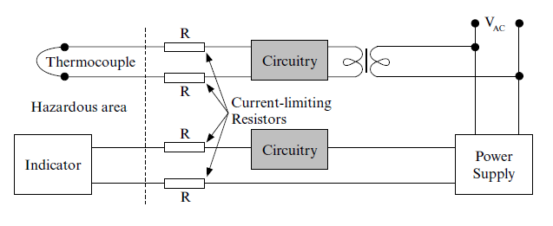
Module 6: Electronic safety devices (continued)
SERIES PROTECTIVE ELEMENTS
Current-limiting resistors are commonly used as a form of series protection in restricting the amount of current reaching hazardous areas.
www.futuremanagers.com

Slide 64
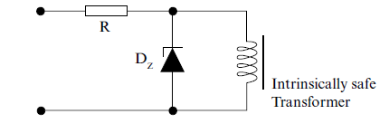
Module 6: Electronic safety devices (continued)
SHUNT PROTECTIVE ELEMENTS
The ability to cause an unsafe condition of inductors can be reduced substantially by shunting the inductance with diodes, resistors and capacitors. The most common technique used is to employ shunt diodes.
www.futuremanagers.com

Slide 65
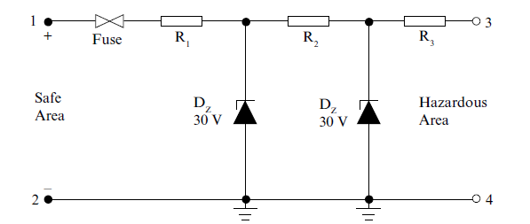
Module 6: Electronic safety devices (continued)
SERIES-SHUNT PROTECTION
Gaining increased acceptance in many countries is a special form of series-shunt protection called the ‘redding barrier’ or Zener barrier. It is usually designed to ensure that when the mains supply is applied to terminal 1 (zone 2 area), the voltage and current at terminal 3 (zone 0 area) are safe
www.futuremanagers.com

Slide 66
Module 7: Electronic power control
OPEN- AND CLOSED-LOOP SYSTEMS
The open-loop process control system is one in which a human operator is used to make changes or to take corrective action during the manufacturing process.
An open-loop control system does not employ feedback and the control element has no reference data concerning the variable being controlled.
www.futuremanagers.com

Slide 67
Module 7: Electronic power control (continued)
CHARACTERISTIC OF CLOSED-LOOP SYSTEMS
The final measure of success of a closed-loop control system would be the degree of closeness between the value (set-point) and the measured value of the controlled variable, regardless of the frequency and magnitude of load or set-point changes. The second characteristic is the speed of response (or setting time) that is, the time interval between the detection of the error and the completion of the corrective action.
www.futuremanagers.com

Slide 68
Module 7: Electronic power control (continued)
CHARACTERISTIC OF CLOSED-LOOP SYSTEMS (CONT)
The third characteristic is the offset, also known as residual error or steady-state error. The residual error is the final difference between the desired value and the measured value of the controlled variable after the system has responded to a measurable change in the desired value or controlled output.
www.futuremanagers.com

Slide 69
Module 7: Electronic power control (continued)
ASSESSMENT OF STABILITY
This transient response characterises the stability of the system. A system is defined as stable if its impulse response approaches zero as time approaches infinity. A system is defined as being unstable if, with zero input, the output increases indefinitely.
www.futuremanagers.com

Slide 70
Module 7: Electronic power control (continued)
TYPES OF CLOSED-LOOP SYSTEMS
Closed-loop control systems can be divided into two main groups:
Regulator systems; and
Follow-up systems.
www.futuremanagers.com

Slide 71
Module 7: Electronic power control (continued)
COMPUTER-AIDED-DESIGN (CAD)
The speed, memory capabilities and facilities provided by computers allow rapid design of complex tasks as well as research and development of projects that previously would have taken years to put onto the drawing board.
www.futuremanagers.com

Slide 72
Module 7: Electronic power control (continued)
COMPUTER-AIDED-MANUFACTURE (CAM)
A CAM system can be defined as any system that uses a central control computer, also called a host, linked to other intelligent devices in a manufacturing environment.
www.futuremanagers.com

Slide 73
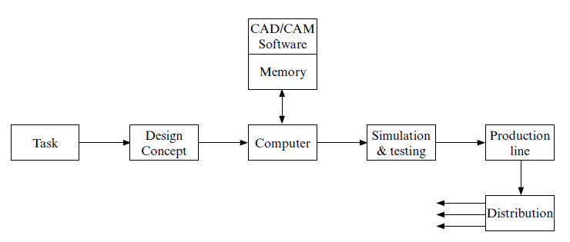
Module 7: Electronic power control (continued)
CAD/CAM SYSTEM
The ultimate in industrial automation is the CAD/CAM system. The CAD system is used to design the project while the CAM system is used to manufacture it.
www.futuremanagers.com

Slide 74
Module 7: Electronic power control (continued)
UNINTERRUPTABLE POWER SUPPLY (UPS)
There is an ever increasing number of computerised, electrical and electronic systems in the industrial, medical and office environment which require an uninterrupted power supply to prevent shut down or damage to critical equipment and systems in the event of a power failure. Uninterruptable power supplies can be divided into two main categories namely:
Large industries, and
Office orientated UPS’s.
www.futuremanagers.com

Slide 75
Module 7: Electronic power control (continued)
INDUSTRIAL UPS’S
There are basically two types of industrial UPS systems, namely; the transfer system and the continuous (or float) system.
www.futuremanagers.com

Slide 76
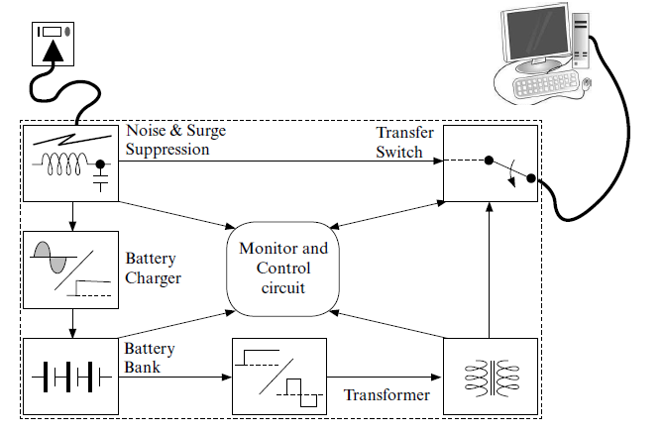
Module 7: Electronic power control (continued)
OFFICE ORIENTATED UPS’S
www.futuremanagers.com

Slide 77
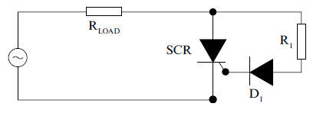
Module 8: Thyristor devices and scr speed control
PRACTICAL TRIGGER CIRCUITS
To trigger a thyristor positively in the shortest time it is desirable to have a gate current with a fast rise time up to the maximum permitted value. The figure below illustrates a crude firing arrangement the object of which is to control the load voltage with respect to the input waveform.
www.futuremanagers.com

Slide 78

Module 8: Thyristor devices and scr speed control (continued)
SCR RATINGS
Given a forward diode or thyristor current $I_{F}$, which is turned off at a given $\frac{di}{dt}$rate, the current will go into reverse until the carrier storage charge $Q_{rr}$ is recovered. At defined values of $I_{F}$ and $\frac{di}{dt}$, a particular device will have rated values of $Q_{rr}$ (the reverse recovery charge) associated with a reverse recovery time $t_{rr}$ and a reverse recovery current.
www.futuremanagers.com

Slide 79
Module 8: Thyristor devices and scr speed control (continued)
LOSSES AND CHARACTERISTICS OF SCR DEVICES
The sources of loss in power semiconductor devices include:
The loss during forward conduction which is a function of the forward voltdrop and conduction current.
The loss associated with the leakage of current during the blocking state.
The loss occurring in the gate circuit from energy input from the gating signal in practice, with pulse firing these losses are negligible.
The switching loss.
www.futuremanagers.com

Slide 80
Module 8: Thyristor devices and scr speed control (continued)
DC LINE COMMUTATION
Many applications of thyristors are to be found where the supply is a DC source. In order to turn off the SCR in the case of a DC supply, means must be employed whereby the current in the device is reduced to zero (or at least below the threshold value for a significant period of time) and a reverse voltage applied for sufficient time to enable the recovery of the device blocking state.
www.futuremanagers.com

Slide 81
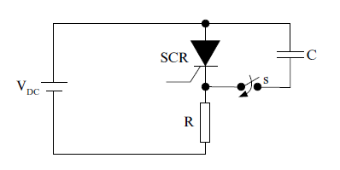
Module 8: Thyristor devices and scr speed control (continued)
PARALLEL CAPACITANCE COMMUTATION
When the thyristor shown below is switched on the current will equal V/R. To turn off the thyristor, a capacitor charged as shown can be switched across the thyristor by closing switch:
www.futuremanagers.com

Slide 82
Module 8: Thyristor devices and scr speed control (continued)
RESONANT COMMUTATION
The self-oscillating property of a capacitor-inductor combination can be utilised to turn off the load thyristor at a given time after turn-on without the need for a second or auxiliary thyristor. The series resonant circuit must be under damped for the thyristor current to attempt to reverse and turn-off to take place. In the parallel resonance circuit, the capacitor is charged to the level of the battery voltage when connected.
www.futuremanagers.com

Slide 83
Module 8: Thyristor devices and scr speed control (continued)
RECTIFIER CIRCUITS AND DEVICES
A rectifier circuit is one which links an AC supply to a DC load, that is, it converts an alternating voltage supply to a direct voltage. The direct voltage so obtained is not normally at 100% level, as from a battery source but contains an alternating ripple component superimposed on the mean (DC) level.
www.futuremanagers.com

Slide 84
Module 8: Thyristor devices and scr speed control (continued)
ADVANTAGES OF DC MOTOR SPEED CONTROL
The main advantages of using DC motors are:
A wide range of speed control is possible.
Can operate under constant or variable torque conditions.
Rapid acceleration, deceleration and reversing.
Open- or closed-loop operation.
Operate under regenerative conditions, and
Range from fractional kW to 7500 kW.
www.futuremanagers.com

Slide 85
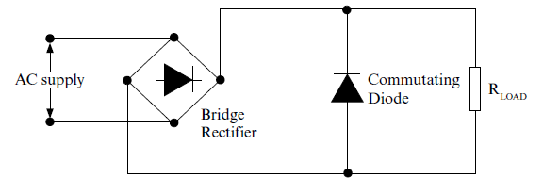
Module 8: Thyristor devices and scr speed control (continued)
COMMUTATING DIODE
Many circuits, particularly those which are half- or uncontrolled, include a diode across the load as illustrated below.
www.futuremanagers.com

Slide 86
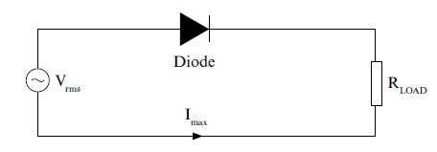
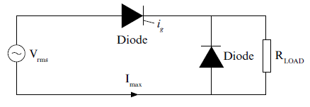
Module 8: Thyristor devices and scr speed control (continued)
SINGLE PHASE HALF-WAVE CIRCUITS
The uncontrolled half-wave rectifier circuit illustrated below is referred to as such since it possess no thyristor rectifier devices.
The single-phase half-wave circuit can be controlled by the use of a thyristor as illustrated below.
www.futuremanagers.com

Slide 87
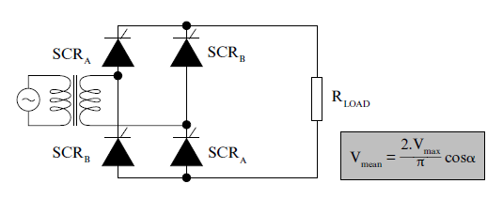
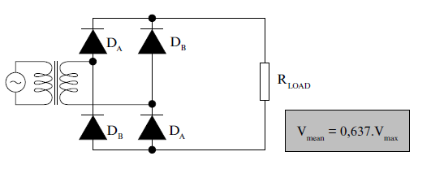
Module 8: Thyristor devices and scr speed control (continued)
BRIDGE RECTIFIER CIRCUITS
A single-phase bridge circuit connection is illustrated below in its simplest diagrammatic layout:
The fully controlled circuit has thyristors in place of the diodes:
www.futuremanagers.com

Slide 88
Module 8: Thyristor devices and scr speed control (continued)
THREE-PHASE BRIDGE RECTIFIERS
The three-phase bridge connection is most readily seen as a full-wave connection. The load is fed via a three-phase half-wave connection, the return current path being via another half-wave connection to one of the three supply lines, no neutral required.
www.futuremanagers.com

Slide 89
Module 8: Thyristor devices and scr speed control (continued)
CONVERTERS
Frequency conversion techniques can be considered to cover those methods by which it is possible to take a fixed frequency (or DC source) and convert this energy to provide a load with a different or variable frequency supply.
www.futuremanagers.com

Slide 90
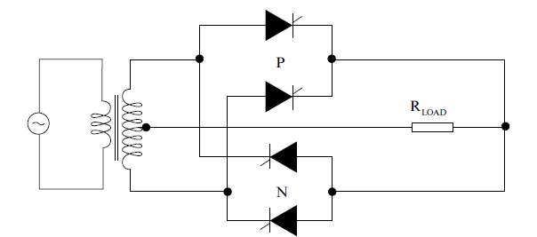
Module 8: Thyristor devices and scr speed control (continued)
CYCLO-CONVERTERS
The principle of the cycloconverter can be demonstrated by using the simplest possible single phase input to single phase output with a pure resistance as load. Each converter is a bi-phase half-wave connection, the positive group labelled P and the negative group (for reverse current) labelled N.
www.futuremanagers.com

Slide 91
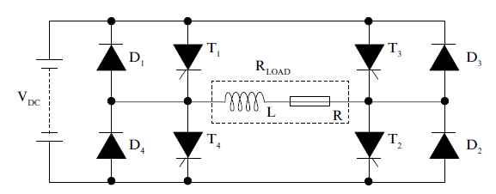
Module 8: Thyristor devices and scr speed control (continued)
INVERTERS
The basic circuit of a typical single phase bridge inverter (without the commutating elements) is illustrated below:
www.futuremanagers.com

Slide 92
Module 8: Thyristor devices and scr speed control (continued)
AC MOTOR SPEED CONTROL
Although the DC motor lends itself more easily to speed control than does the AC motor, the major use of power semi conductor devices in AC motor speed control is centered on variable output frequency inverters. For effective AC motor speed control, compared to that of DC motor speed control, a greater complexity of power and control equipment is required. This additional cost has to be set, however, against the lower cost of the cage induction motor.
www.futuremanagers.com

Slide 93
Module 8: Thyristor devices and scr speed control (continued)
ADVANTAGES OF AC MOTOR SPEED CONTROL
High efficiency against low motor cost;
Compact design and light weight with high torque;
Low maintenance; and
Wide range of motor designs available.
www.futuremanagers.com

Slide 94
Module 8: Thyristor devices and scr speed control (continued)
AC DRIVE CONSIDERATIONS
With inverter-fed variable-speed drives, energy savings are possible by matching the voltage to the power demand at a given speed so as to maximise efficiency when under loaded. Practical examples in the industry where savings are possible are in pump and fan drives where the torque is proportional to the square of the speed with the motor loss a minimum at all speeds.
www.futuremanagers.com

Slide 95
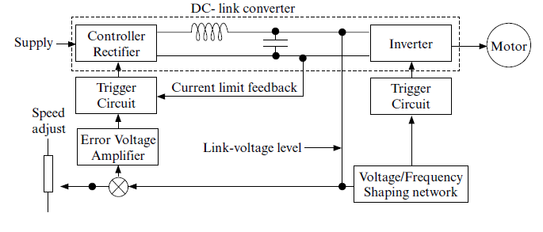
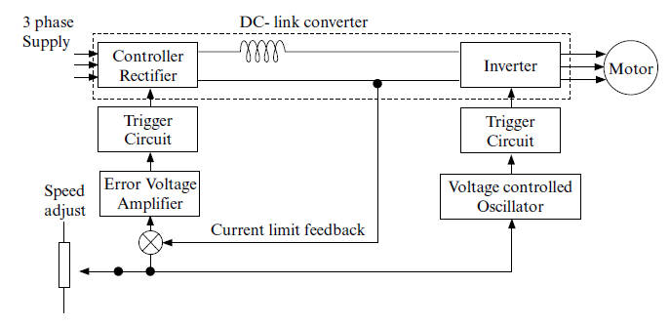
Module 8: Thyristor devices and scr speed control (continued)
TYPES OF AC DRIVES
Constant voltage AC drives:
Constant current AC drives:
www.futuremanagers.com

Slide 96
Module 8: Thyristor devices and scr speed control (continued)
ELECTRICAL BRAKING
Electrical braking can be achieved in one of three ways:
Plugging is the braking technique of reversing the armature connections to the supply via a resistor for the motor to rotate finally in the reverse direction.
Regenerative braking is applied to devices where there is a need to preserve energy, as is the case with battery operated vehicles.
Dynamic braking is applied to those areas where rapid slowdown is required and regenerative braking is not possible.
www.futuremanagers.com

Slide 97
Module 9: Programmable logic controllers
INTRODUCTION
Programmable controllers cover a wide spectrum of equipment and capabilities which range from simple relay replacing with minimum I/O and memory capability to large supervisory controllers which perform a variety of control and data acquisition functions.
www.futuremanagers.com

Slide 98
Module 9: Programmable logic controllers (continued)
HARD- AND SOFT WIRING VS RELAY- AND LADDER LOGIC
When relays and contactors are individually wired together to solve typical control problems it is known as hard wiring. This conventional control technology employing relay and contactor controls, as well as inter-wired solid state component controls are referred to as hard-wired control systems where the wiring represents the program. In developing a program to replace the functions of the described hard wiring control system, you are said to be engaging yourself with soft wiring.
www.futuremanagers.com

Slide 99
Module 9: Programmable logic controllers (continued)
PROGRAMMABLE LOGIC CONTROLLERS (PLC’S)
The PLC accepts data from input devices (sensors, limit switches, push buttons, proximity switches, etc), and it then performs logical decisions in an orderly repetitive sequence determined by the program which has been entered into its memory by the user. The PLC also provides output signals for the control of machines, plants, processes, etc.
www.futuremanagers.com

Slide 100
Module 9: Programmable logic controllers (continued)
THE BUILDING BLOCKS OF A PLC
A PLC generally consists of two (or more) items namely:
Programmer (hand-held unit);
Programmable controller (basic unit); and
Expansion units; (if required).
www.futuremanagers.com

Slide 101
Module 9: Programmable logic controllers (continued)
MODULAR FUNCTIONS WITHIN THE CONTROLLER
The CPU is a microprocessor containing circuitry that performs logical decision-making functions; that is, it reads in the status of the control system, makes a decision(s) based upon the logic that has been programmed and then provides the actuating portion of the control system with its decision(s).
www.futuremanagers.com

Slide 102
Module 9: Programmable logic controllers (continued)
MODULAR FUNCTIONS WITHIN THE CONTROLLER (CONT.)
User accessible memories are normally contained in compact plug-in cartridges. Memory devices and cartridges available usually take the form of one of the following; CMOS RAM, EPROM or EEPROM devices. Internal CMOS RAM memory devices are usually battery backed-up mounted on the inside of the base unit.
www.futuremanagers.com

Slide 103
Module 9: Programmable logic controllers (continued)
MODULAR FUNCTIONS WITHIN THE CONTROLLER (CONT.)
Complimentary metal-oxide semiconductor random access memory (CMOS RAM) is the most common type of memory used in PLC’s for storing both logic and data Although CMOS RAM is fast, low power memory that can easily be read and written into (examined and/or changed), it is volatile memory; that is, it will lose its data when power is removed.
www.futuremanagers.com

Slide 104
Module 9: Programmable logic controllers (continued)
MODULAR FUNCTIONS WITHIN THE CONTROLLER (CONT.)
EPROM and EEPROM memories are programmable read only memory devices, being low power, fast and retentive upon loss of power, thus not requiring a battery back-up to hold data. The data in of these memories can be read at any time but in order to change the data some special action is required on the part of the user.
www.futuremanagers.com

Slide 105
Module 9: Programmable logic controllers (continued)
APPLICATIONS USING PLC’S
Some of the industries employing PLC’s include:
Electrical engineering;
Mechanical engineering;
Chemical engineering;
Mining; and
Instrumentation.
www.futuremanagers.com

Slide 106
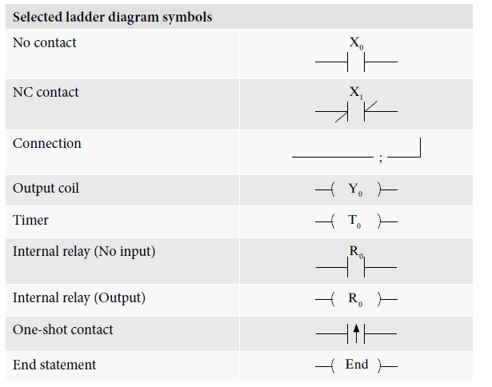
Module 9: Programmable logic controllers (continued)
LADDER DIAGRAM PROGRAMMING
www.futuremanagers.com

